Slide 1
DfE Regions Group update May 2025
Jade Poole– Team Leader, Cornwall and the Isles of Scilly

Slide 2


The opportunity mission and Regions Group
The Opportunity Mission is focused on breaking down barriers to opportunity. We will deliver this through our mission pillars.
Best start in life - high-quality early education; early-child health; home-learning environment; family support
Every child achieving and thriving - high and rising school standards with a broad curriculum; excellent teachers; an inclusive approach to SEND; wider support and enrichment
Skills for opportunity and growth - a strong skills offer; pathways into work including youth guarantee, work experience, careers advice
Family security - removing underlying barriers to opportunity including tackling child poverty, improving housing and keeping children safe
The department will support a mission-led government, working closely with other departments and partners. As well as leading on opportunity, DfE has a key role in contributing to all the missions – growth, health, safer streets and energy.

Slide 3

The Children’s Wellbeing and Schools Bill
Keeping Families Together and Children Safe:
Mandating local authorities to offer family group decision-making meetings
Improving information sharing across agencies
Strengthening the role of education in safeguarding
Implementing multi-agency child protection teams
Driving High and Rising Standards for Every Child:
Delivering commitments on school admissions, qualified teacher status, and the national curriculum
Repeal of Duty to Make Academy Order; Extension of Statutory Pay and Conditions to academies
Introducing new duties for schools and local authorities to co-operate on admissions and place planning; extending local authorities’ powers to direct academies to admit children
Changing the legal framework for opening new state-funded schools
Removing Barriers to Opportunity in Schools:
Providing access to free breakfast clubs for every primary school child.
Limiting the number of branded uniform items that schools can require
Creating a Safer and Higher Quality Education System for Every Child:
Introducing Children Not in School Registers
Other measures relate to:
Making a Child-Centred Government
Cracking Down on Excessive Profit Making
Supporting Children in the Care System to Thrive

Slide 4
Regional Improvement for Standards and Excellence (RISE)
Part 1 – RISE updates
Part 2 – Regional priorities overview and discussion

Slide 5






RISE Teams: Objectives
Ultimately, the goal of RISE teams will be to raise standards for all schools, as part of the government’s Opportunity Mission. Through targeted intervention and a universal service, RISE teams will work to ensure that capacity and expertise from across the school system is used to deliver improvement. Their specific objectives will be to ensure that:
Schools facing particular challenges improve rapidly through bespoke targeted intervention for 12-24 months. Where necessary, RISE teams will secure support high-quality organisations with a strong track record of improvement, such as an LA partnership or a MAT. For now, our focus is stuck schools. From September 26, we will provide targeted interventions to schools judged to require significant improvement.
Every school, with its Responsible Body, can navigate a path to improvement drawing on local expertise. Most schools will do this by themselves, aided by a more granular evaluation of school performance in the Report Card. However, RISE teams will make it easier for schools to do this by delivering a universal service to schools, signposting to hubs and best practice, facilitating connections between schools and trusts, and promoting peer review and networking.
Every part of the country has a coherent set of local area priorities, working across local authorities and dioceses so that local partners work collaboratively to solve issues affecting children in their communities.

Slide 6

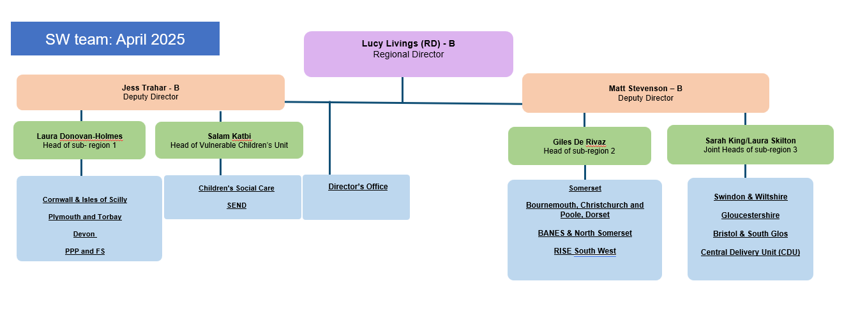
South West regions group:
The RISE team is part of SW RG
RISE colleagues will work very closely with other SW RG colleagues – including the delivery teams that you interact with regularly.

Slide 7
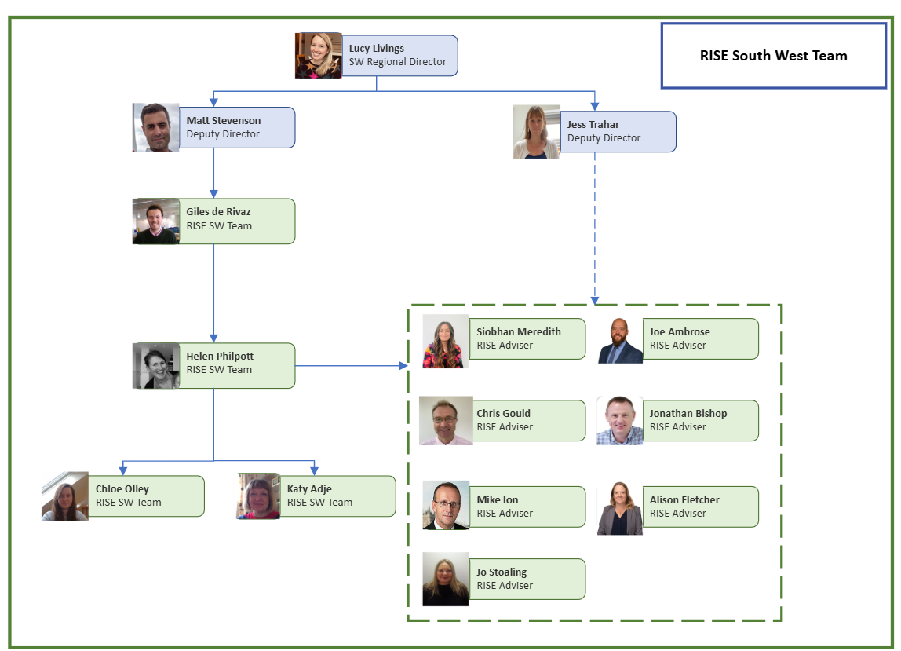


SW RISE team

Slide 8

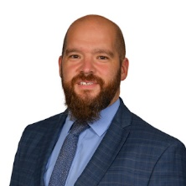
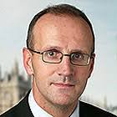
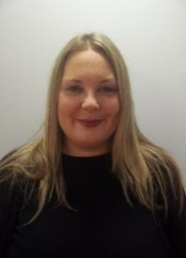
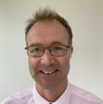
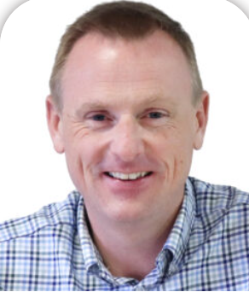
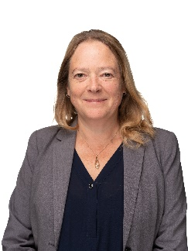


Our SW RISE advisers
Siobhan Meredith – Executive Director of Education, The Ted Wragg Trust
Joe Ambrose – Associate Director of Growth and Development, Greenshaw Learning Trust
Mike Ion – former Education Director, Avanti Schools Trust
Jo Stoaling – Headteacher, Three Ways Special School
Chris Gould – Director of Education and Deputy CEO, Truro and Penwith Academy Trust
Jonathan Bishop – CEO Cornerstone Academy Trust
Alison Fletcher – Director of CLF Institute, CLF

Slide 9






Targeted RISE intervention: step by step (1)
2
Eligibility
Initial diagnosis
1
Match
Diagnose and plan
Implement
Monitor
Phase 1
Phase 2
Phase 3
Phase 4
Phase 5
Start
Term 1
Terms 2-7
Terms 2-7
We are strengthening our tools for faster and more effective school improvement with the introduction of our new RISE teams.
Eligibility:
  Schools graded Requires Improvement – or equivalent* – at their most recent Ofsted inspection and also graded below Good at its previous inspection, and where no structural change has taken place since the most recent Ofsted inspection;
  Inadequate schools that are currently in a category of concern and where no structural change has taken place since the most recent Ofsted inspection.
Initial diagnosis carried out by a RISE adviser.
  Option 1 (for schools earlier on in improvement trajectory): additional capacity and support is needed, including from an organisation that brings experience and capacity to help. We envisage this will be most schools.
  Option 2 (for schools further on in improvement trajectory): the responsible body (RB) has strong capacity and the school is improving. The full RISE service would not be needed but the school would be monitored/given opportunities for regular check ins. We envisage this will be a smaller number of schools.
Match (option 1 schools): RISE advisers will work collaboratively with schools and RBs to commission support from a high-quality supporting organisation. They will meet the school’s trust or local authority, as well as the school’s leadership, and diocese where applicable, to discuss improvement priorities. The supporting organisation will work with the school’s RB to deliver improvements.
* ‘or equivalent’ = less than ‘good’ judgements in Quality of Education or Leadership and Management for schools inspected after September 2024

Slide 10
Targeted RISE: step by step (2)
Eligibility
Initial diagnosis
Match
Diagnose and plan
Implement
Monitor
Phase 1
Phase 2
Phase 3
Phase 4
Phase 5
Start
Term 1
Terms 2-7
Terms 2-7
Diagnose and plan:
  The adviser, school, diocese (where applicable) RB and supporting organisation will co-construct an improvement plan (or update/refresh any current plans).
  RISE teams will be able to draw on funding to support this activity where necessary. Funding could potentially cover, for example: including training, resources, additional hub support, leadership support and additional staffing to cover specific and time limited activities – but there is no guarantee of funding.
Implement & monitor:
  Led by the RB and working with the supporting organisation, to happen over an agreed period (12-24 months). The RISE adviser is there to support and monitor progress of the implementation of the plan, agreeing how best to do this with the RB.
  The RB – the trust for an academy, and the governing body and LA for a maintained school – will continue to be accountable for their schools, including driving school improvement.

Slide 11
Targeted Intervention update
Responsible bodies for all eligible schools were contacted in February.
4 ‘test & learn’ schools:
  All schools and responsible bodies have engaged positively with our RISE advisers.
  Next steps involve finalising the matches where these are being recommended and then moving on to improvement plans being co-constructed.
  Lessons learnt exercises have been taking place nationally and will be fed forward in the future.
  “We thoroughly enjoyed the RISE adviser’s visit and found it extremely useful and positive. Our thanks to the adviser for being so open and supportive.”
20 schools in our April cohort. RISE advisers will shortly begin working with these schools.
We will engage with the other eligible schools from September.

Slide 12



Reminder: Universal Service – a catalyst for change
The RISE universal support service is for all schools. It will transform how schools, with their responsible bodies, can access support and how the sector engages collectively in providing support.
RISE teams will map existing national and local best practice and make sure signposting to support is much clearer than it is now
RISE teams will foster an open culture of sharing best practice, including through regional roadshows or networks, and robust peer review
RISE teams will convene and empower local partners to deliver change against local priorities including commissioning capacity where needed
National priorities
Attainment with a focus on English and maths
Reception Year quality
Mainstream inclusion
Attendance
Regional and local priorities
Regional Directors and RISE Teams working with LAs, dioceses and mayoral combined authorities to identify thematic improvement priorities

Slide 13




Universal Service – national delivery model:
Data- and insight-informed conversations
Data identifies responsible bodies for support and challenge conversations led by RISE teams with follow-up actions for the RB.
In-person conferences or webinars
Consistent national agenda and VIP speakers, some sessions tailored to regional context and designed by RISE teams with RISE advisers.
National or regional centres of excellence
Designated or quality assured against national criteria, commissioned to lead 1:1 or 1: many improvement activity by RISE teams.
Guidance and other published materials
Disseminated through RISE infrastructure (gov.uk, regional newsletters, local partner newsletters, RISE advisers).

Slide 14
…but what does this all actually look like in the SW?
Opportunities and events for colleagues across the sector to come together to share and learn from best practice linked to the national priorities:
  3 national attendance conferences aimed at sector leaders (trust CEOs and LA SI leads) this summer
  Developing delivery work on the other three national priorities over the summer term and into the next academic year.
  Discovery mornings across the SW aimed at bring school leaders together to share best practice – initial focus on attendance but this will broaden to other national priorities in time
  Reception year quality SW conference (1st July, Sandy Park Exeter – Eventbrite links to follow via email)
  South West networks for school and trust leaders
Gaining a better understanding of opportunities for local partnership working through ongoing engagement with our sector partners, and ensuring our future work reflects this
Looking at how we can improve signposting of the support available to schools

Slide 15
Discovery Mornings
Discovery Mornings are targeted school visits designed to showcase excellent practice around key national and regional priorities. Each session is a short, sharp opportunity for school leaders to see outstanding work in action, followed by a focused call-to-action discussion.
Discovery Mornings will be delivered as a series of 3-4 events on a national and/or regional RISE priority. Events will take place approximately once per month with the aim to have a good geographical spread across the South West so that school leaders can attend Discovery Mornings local to them.
Your secondary school leaders will have received invitations to the first series of discovery mornings which are focussed on secondary attendance, following on from the March attendance conference in Exeter.
School leaders can sign up for their local Discovery Morning via the Eventbrite pages here.
Series 1 – attendance Discovery Mornings:
Blaise High School, Bristol – Thursday 26th June, 8am – 11am
Marine Academy Plymouth – Friday 4th July 8am – 11am
Hans Price Academy, North Somerset – Thursday 25th September 8am – 11am

Slide 16
Hosting Discovery Mornings
We're keen to expand Discovery Mornings further and are currently looking for schools to host future sessions. Hosting is straightforward: the Department for Education (DfE) team will organise sign-ups, marketing, and logistics. If you believe your schools have excellent practice to showcase under any of the national RISE priorities, please encourage them to contact the RISE team.

Slide 17
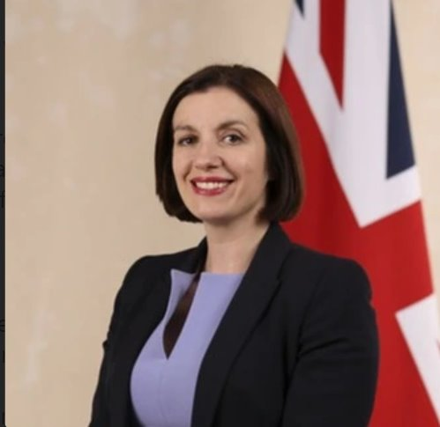
SoS speech to ASCL conference – RISE national priorities
“Our new RISE teams…taking what’s best in schools and trusts and spreading it, so that all children can benefit”
RISE national priorities:
Attainment, with a focus on English and Maths
Inclusive mainstream
Reception year quality
Attendance
Inclusion in Practice call for evidence
“We are urging schools and stakeholders leading the way to share their approaches…they will help shape a national resource that ensures every child, in every school, has the best opportunity to succeed” (Tom Rees)

Slide 18
Attainment and Reception year quality – potential SW areas of focus:
Attainment:
Outcomes for pupils experiencing disadvantage, across all KS
KS4 maths outcomes
KS2 outcomes, in writing and particularly in maths
Reception year quality:
Numeracy and literacy
Outcomes for pupils experiencing disadvantage
GLD gender gaps for boys
Are these the right areas of focus?
Are there other particular issues or challenges that we should be focussed on?

Slide 19
Mainstream inclusion and Attendance – potential SW areas of focus:
Mainstream inclusion:
Exclusions and suspensions of children with SEND
Outcomes for pupils experiencing disadvantage
Belonging and wellbeing in schools
Attendance:
Authorised absence rates
Persistent Absence rates, particularly for FSM pupils
Secondary and Special phases
Are these the right areas of focus?
Are there other particular issues or challenges that we should be focussed on?

Slide 20
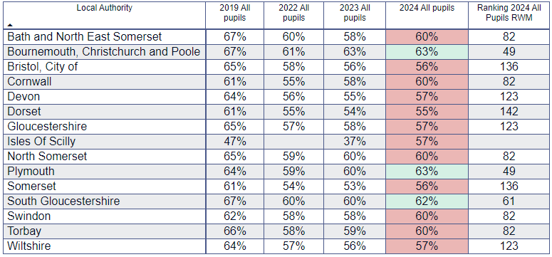
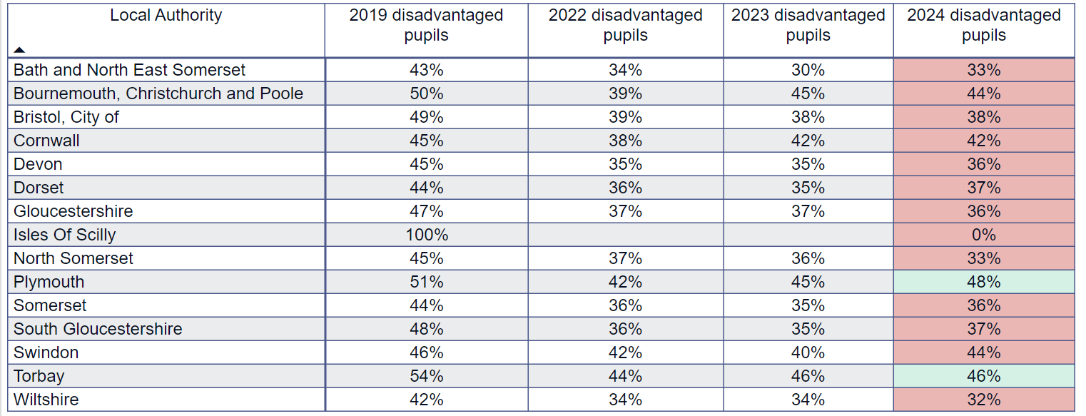
Attainment – KS2
RWM% - all pupils
RWM% - disadvantaged pupils

Slide 21
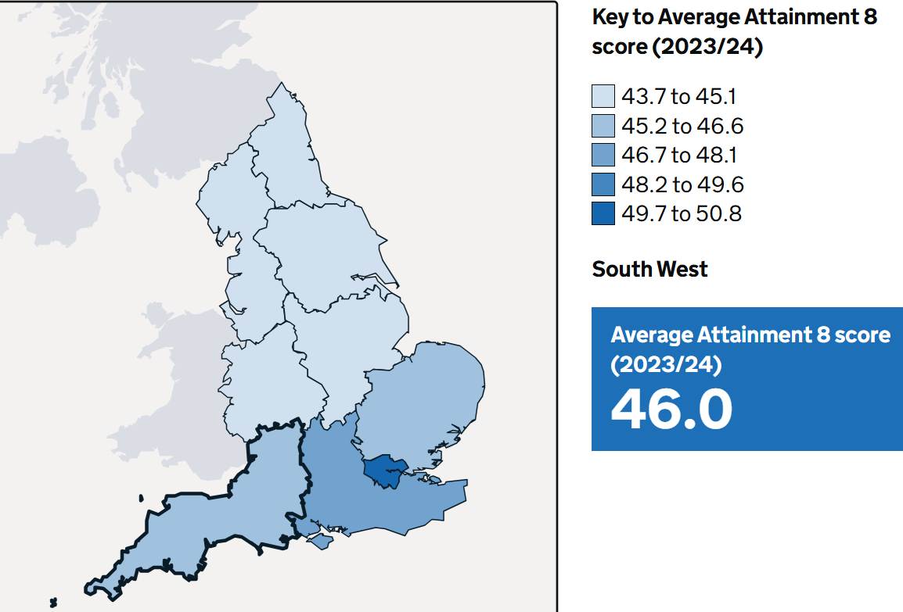
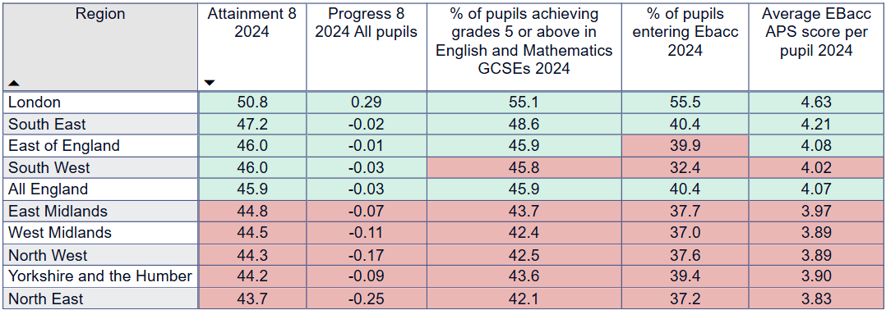
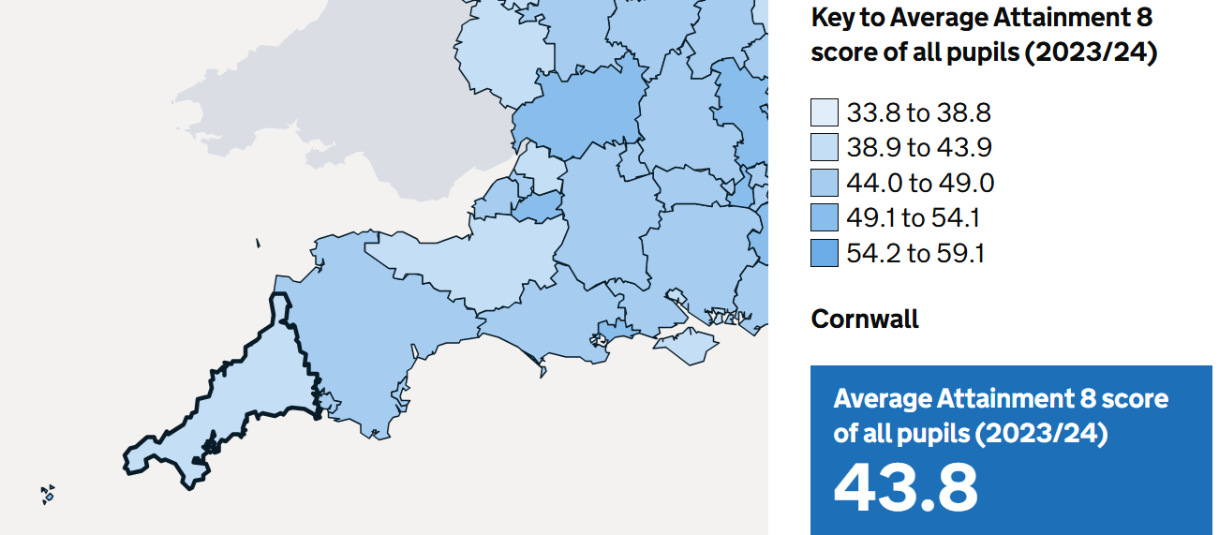

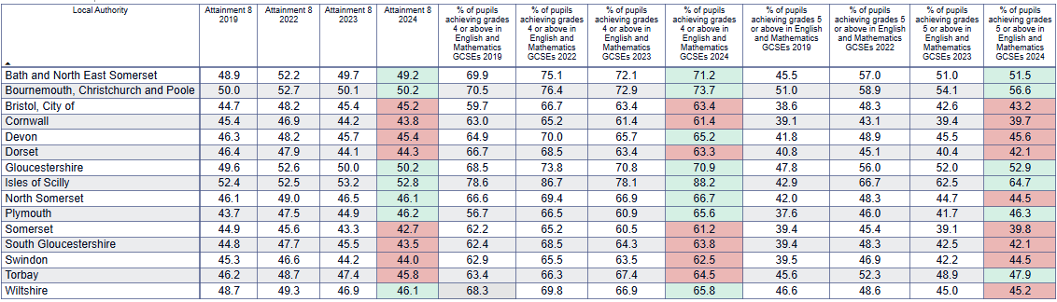
Attainment – KS4
England outcomes – all pupils
South West outcomes – all pupils

Slide 22
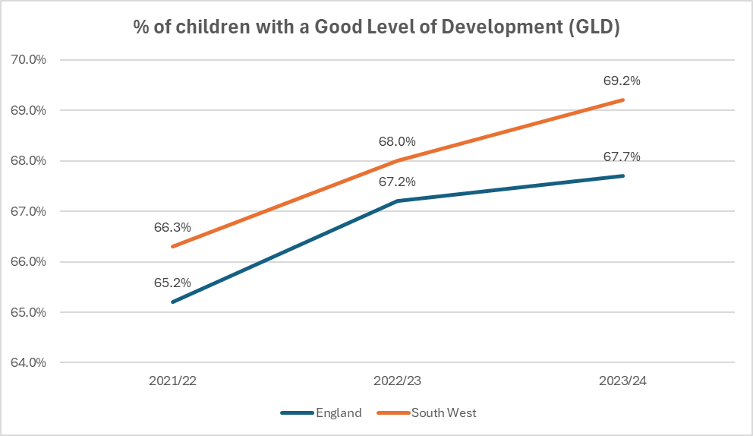
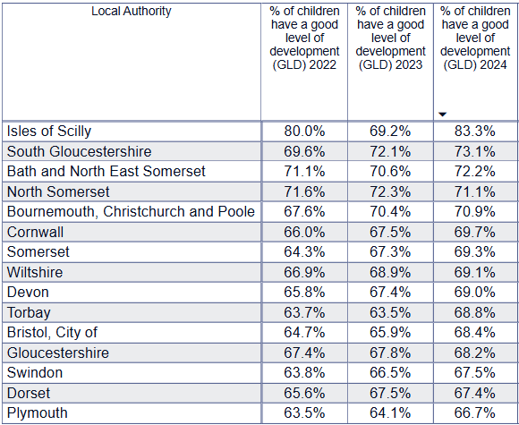
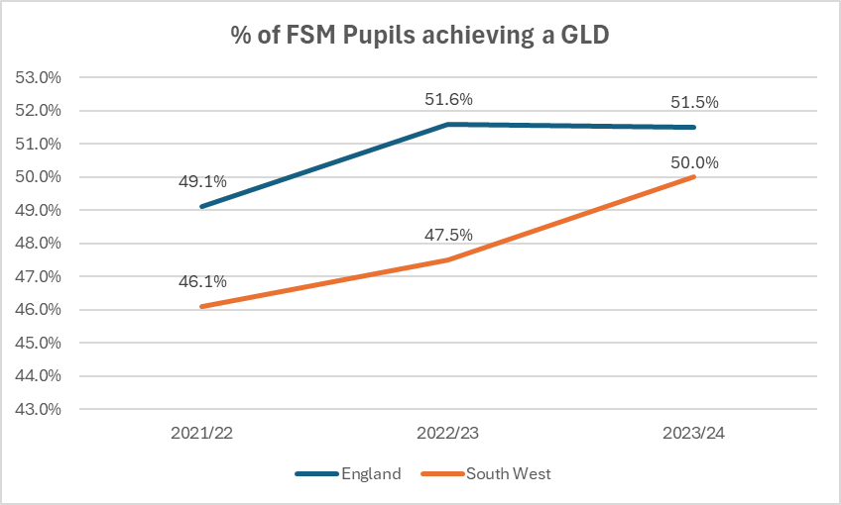
Reception year quality
GLD England/South West:
GLD by South West LA:
2023/24 England South West
All pupils 67.7% 69.2%
Disadvantaged pupils 51.5% 50%

Slide 23
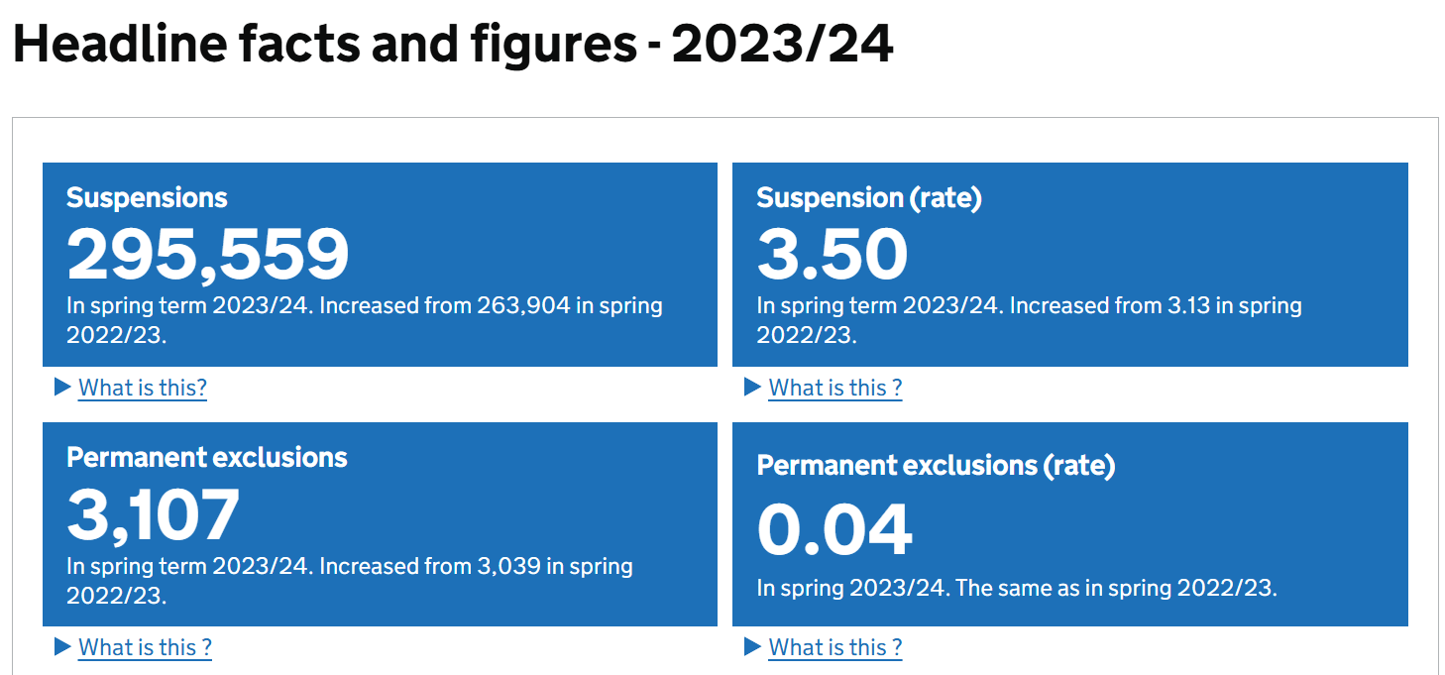
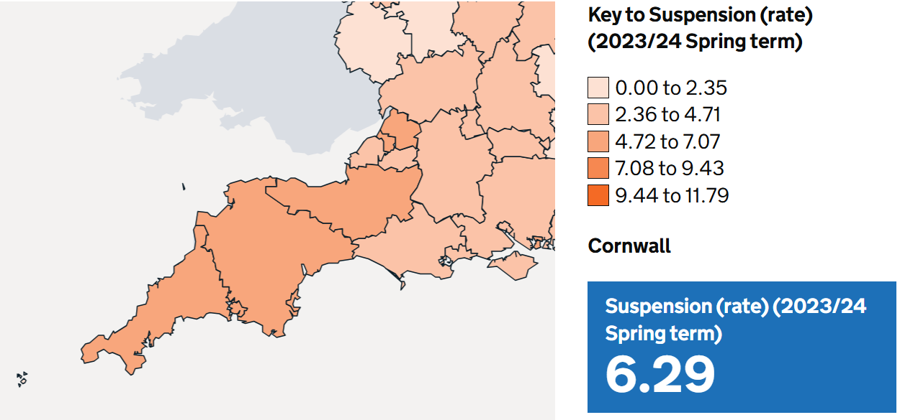
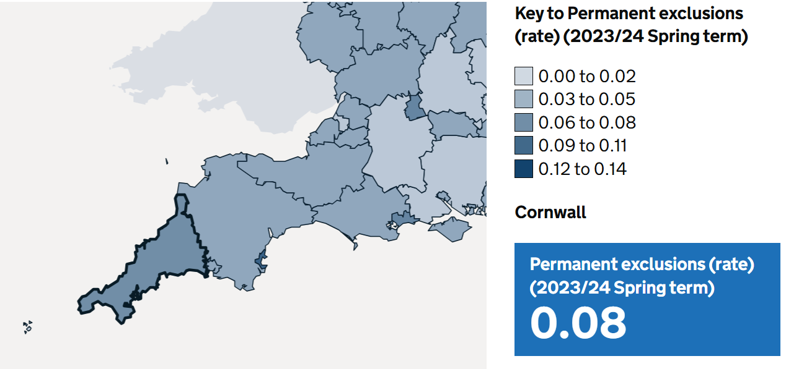
Mainstream inclusion
The Cornwall overall suspension rate was the 3rd highest in the SW
Cornwall’s overall permanent exclusions was the 2nd highest in the SW.
Suspensions and exclusions of pupils with SEND

Slide 24
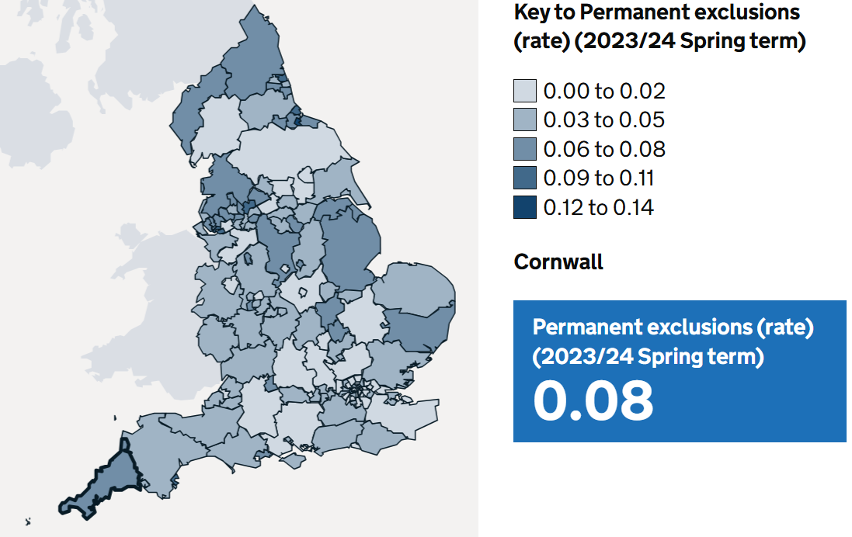
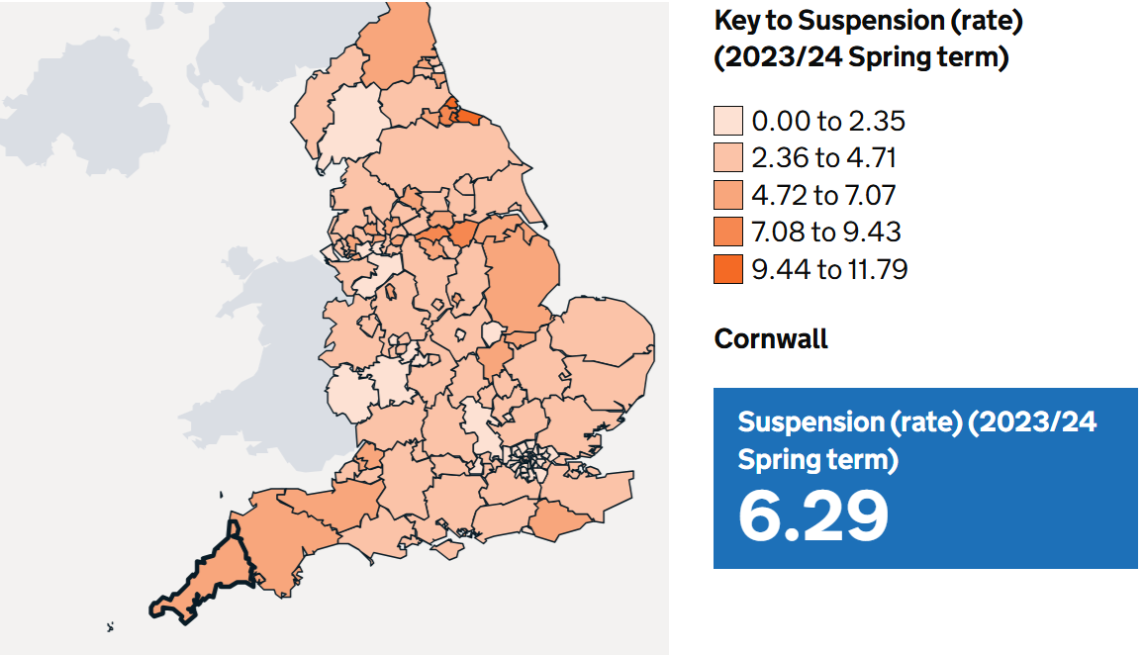
Cornwall exclusions compared to contextually similar LAs
Similarity | County | Suspension rate | Permanent exclusion rate
 | Cornwall | 6.29 | 0.08
Coastal | Devon | 5.95 | 0.04
 | Northumberland | 5.36 | 0.06
 | Essex | 3.39 | 0.03
 | Kent | 2.63 | 0.01
Rural | Somerset | 6.76 | 0.05
 | Dorset | 3.70 | 0.03
 | Cumbria | 2.78 | 0.06
 | Herefordshire | 1.97 | 0.05
Suspensions and permanent exclusions in England, Spring term 2023/24 - GOV.UK

Slide 25
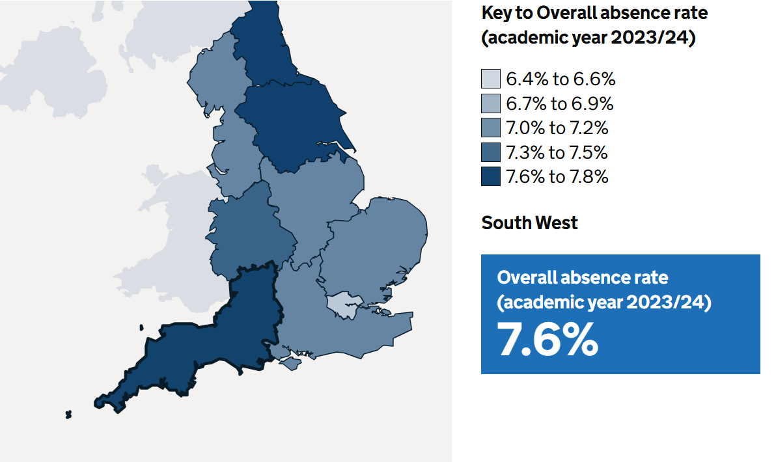
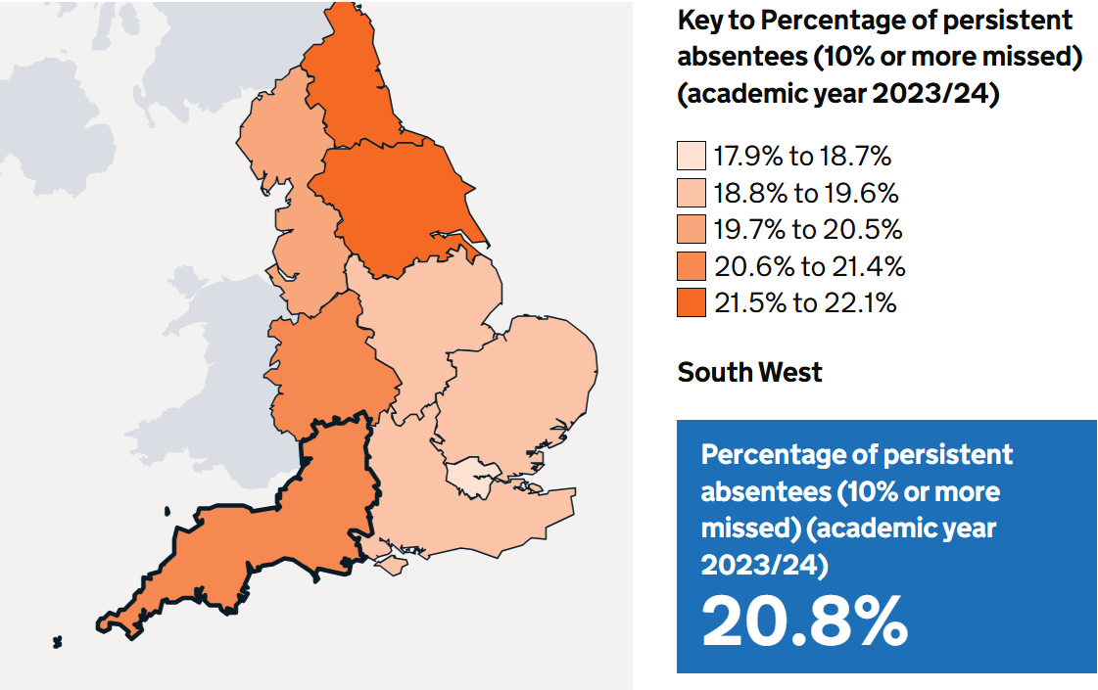
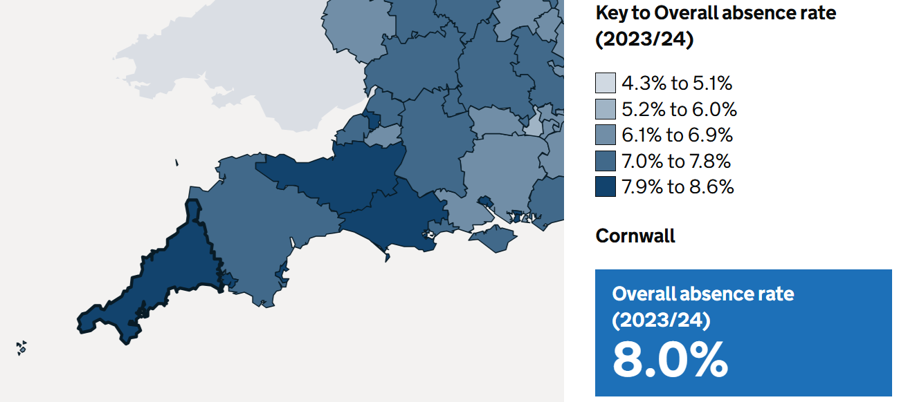
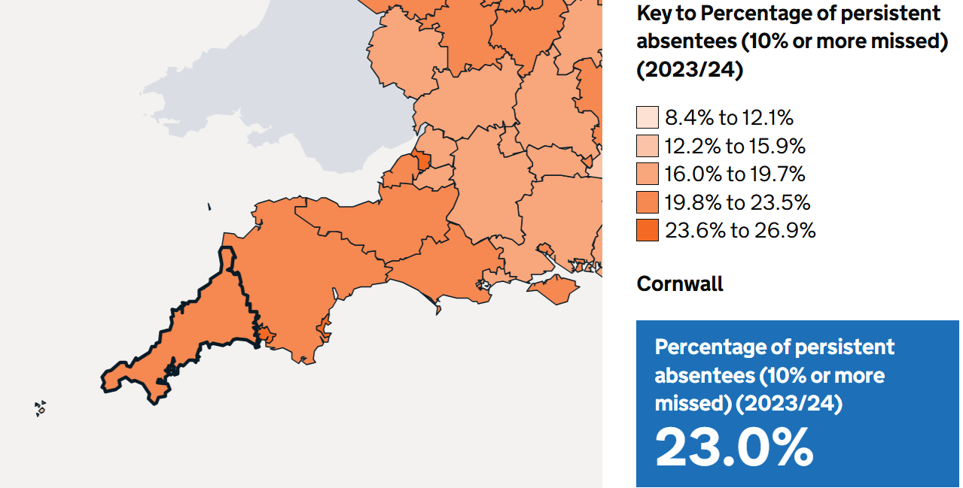
Attendance
Overall absence
Persistent absence
The SW had the 2nd highest regional overall absence rate.
Cornwall had the 4th highest overall absence rate in the SW.
The SW had the fourth highest regional persistent absence rate.
Cornwall had the 4th highest persistent absence rate in the SW.

Slide 26
Attendance
All pupils
Persistent absence FSM/not FSM

Slide 27

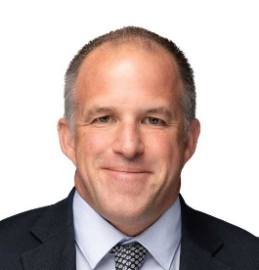

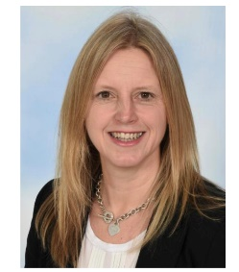
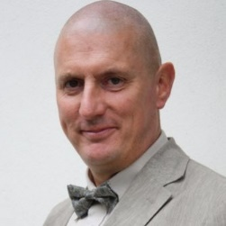


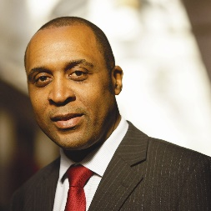
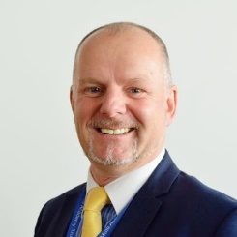


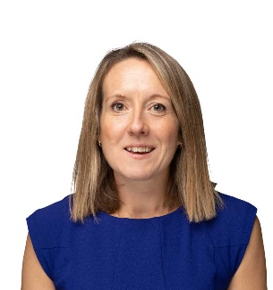



South West schools networks 2024-25
Collaboration on behalf of children in the South West
For all schools
For trust leaders
Disadvantage Network
dnicholls@twhf.org.uk
Primary SI Network
jhicks@dsat.org.uk
Trust Leaders Network
sarah.gardner@olympustrust.co.uk
EDI Network
david.watson@sast.org.uk
Secondary SI Network
jon.lunn@tedwraggtrust.co.uk
CEO and Chair Learning Sets
chloe.olley@education.gov.uk
Attendance Network
Kate.richardson@clf.uk
Inclusion Network
tdexter@futuralearning.co.uk

