Slide 1
Early Years Leaders in Schools
1st October 2025

Slide 2
Agenda
Updates-Early Years Autumn Conference
-Phase 2 School Base Nursery programme
-Safeguarding reforms and changes to the EYFS
National Literacy Trust on Starting school- Jo Knuckey
Project Manager, Early Years (Cornwall)
Starting Reception definition DFE guidance- supporting parents and feeder settings. Discussion.
EY Universal Belonging offer including supporting Armed Forces families
Best Start in Life- new government policy and Cornwall targets
EYFSP data for 2025- strengths and gaps in Cornwall. Discussion about Writing outcomes.
Home Learning- what’s working well?
Integrated 2 year review update and new portal.
Next meeting date- 21st Jan and 29th April 9.30 -12 pm.

Slide 3
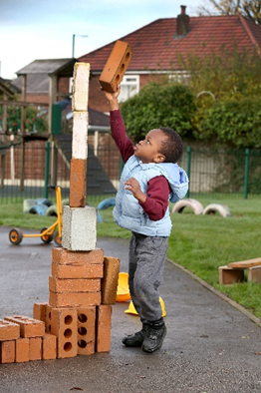
Conference- 21 or 22 November 2025
Playful maths – Building bright futures
Keynote – Dr Catherine Gripton
The power of the practitioner in children’s mathematical play
Our keynote speaker, Dr Catherine Gripton, will take participants on an insightful journey into the powerful role early years practitioners play in shaping children’s early maths skills and setting them up for future success - especially those children who face the greatest challenges.
Participants will discover how their own confidence and attitude towards maths can inspire young learners and the essential skills and proven strategies that truly drive children’s early maths success, helping you make every moment count in your practice.
Participants will explore how to create maths-rich environments filled with purposeful play and meaningful interactions that unlock the magic of continuous provision.
Catherine will also highlight the importance of working closely with families to keep children’s maths learning growing strong beyond the setting
Please apply online:
Sign up/login to www.earlyyears.cornwall.gov.uk/training click on the ‘training’ tab and type EYFS08 in the ‘quick course search’ box.

Slide 4
School based nurseries
In Autumn 2024, the DfE launched Phase 1 of their School-based Nursery Capital Grant Programme. In total, the DfE funded 300 schools across 107 LAs (including 2 schools in Cornwall) for a total of £37 million to provide schools with capital funding towards creating new/expanded nursery provision (through the re-purposing of empty classrooms). In total, over 1,200 schools applied for funding – this was a very popular programme but only 25% of applicants were successful.
This Autumn, the DfE have launched Phase 2 of this programme, with a further £45 million available for schools to bid for. As with Phase 1, schools can bid for up to £150,000 towards capital costs of creating new/expanded nursery provision within their school
Changes;
Funding is now available to Maintained Nurseries to apply
There is no longer the requirement for schools to use empty classrooms for any new/expanded nursery provision
Applications will be scored with disadvantage/deprivation making up 50% of the score for an application
The deadline for submitting applications to the DfE is 5pm on Thursday 11 December 2025. Schools will be informed in April 2026 whether or not their application has been successful.
To apply, schools will need to submit their application through the DfE’s School Based Nursery application page: https://apply-for-school-based-nurseries-capital-grant.education.gov.uk/

Slide 5
EYFS Safeguarding Reforms Sept 2025
What all settings need to know
Early Years Foundation Stage (EYFS) Safeguarding Reforms 2025 - Foundation Years
This 20 minute vodcast provides an overview of the key changes and policy intentions behind them.
There are also further insights from Ofsted inspectors on how these reforms will shape inspection frameworks and expectations of providers.

Slide 6
EYFS Statutory Framework changes
Early years foundation stage (EYFS) statutory framework - GOV.UK
New versions of the EYFS frameworks came into force from 1 September 2025 with changes being made to strengthen the EYFS safeguarding requirements.
The main changes are:
Safeguarding policies and procedures, including concerns about children’s welfare and whistleblowing
Suitable people and safer recruitment
Paediatric First Aid
Safer eating
Toileting and intimate hygiene
Child absence
Safeguarding training (Annex C)
Notes:
Steph
Different versions for group settings and childminders

Slide 7
National Literacy Trust- Jo Knuckey
Everyone Ready for School | National Literacy Trust

Slide 8
Starting Reception
Home - Starting Reception
https://startingreception.co.uk/
Starting-Reception.pdf

Slide 9

Startingreception.co.uk
Felicity Gillespie
CEO Kindred²

Slide 10

Why Starting Reception?
School readiness survey: 25% starting reception not toilet trained; 33% can’t feed or dress independently
Impact huge: 2.5hours of teaching time lost every day and it affects every child
Lack of shared understanding: 9 out of 10 parents say their child is ‘ready’; teachers say it’s closer to half
Nearly half of parents think children aren’t ready because parents don’t think it’s their job
National squeamishness about talking about parenting and there’s no single definition, leaving parents in the dark

Slide 11


















This definition was created collaboratively by:

Slide 12

‘Starting reception’ not ‘school readiness’?
Decision taken by the coalition of authoring organisations
Confusion between the destination of starting reception with the journey of child development which is rooted in strong, loving attachments from birth and powered by joyful play
Plethora of different definitions – we need a single, simple, national definition that parents can trust as a guide and the whole sector can work with

Slide 13
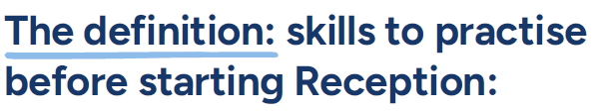




We understand that all children develop at their own pace, and that we’re all learning from birth. When it’s time to start school, some children will need more help than others.
There’s lots you can do at home to build your child’s confidence and independence, helping them feel emotionally and practically prepared to start school.
New skills take time to learn. Practising at home will help your child move into school more easily and with confidence.

Slide 14
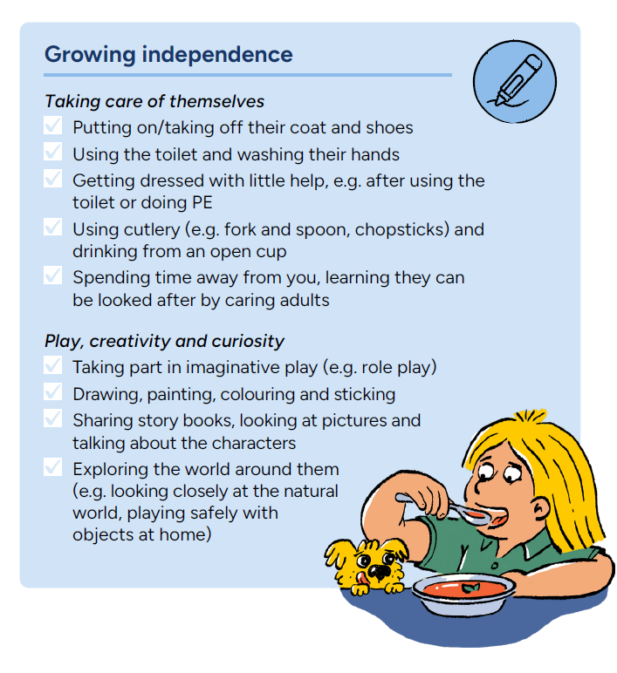
Useful links:
Growing independence
Check out Parentkind’s online advice hub and magazine for parents ‘Be School Ready’
Enjoy Family Corner’s 5 tips to help your child get ready for Reception
Guidance for parents and practitioners - PACEY
Download the free EasyPeasy mobile app for tips and activities to support everyday parenting moments
Taking care of themselves
How can you make separating easier? - Family Corner
Getting dressed and ready for the day - backward chaining information sheet - NHS
Getting ready for the Day – BBC
Toilet training
The Institute of Health Visiting has advice and tips on toilet training
Simple and supportive toilet training advice - ERIC
Potty training and bedwetting - NHS
Pants4School - Down Syndrome UK
Playing, creativity and curiosity
5 steps for brain building through serve and return - Center on the Developing Child at Harvard University
How to follow a child’s interest in play - National Literacy Trust
How to role play with your child - Pretend role play - BBC
How to role play with your child - Playing pretend animals - BBC
Fire up their imagination with drawing - BBC
What is mark-making and why is it important for learning? - PACEY
Sharing story books on World Book Day - BBC
Nature activities for children - BBC
Learning and having fun on the bus - BBC
Play a game of 'What's that sound?' - BBC

Slide 15


Resources for families with additional needs
There are many organisations who can support with information and strategies to prepare you, your child and their educational setting, ensuring a smooth transition and setting them up for future success.
These include:
Family Lives
Speech and Language UK
Dingley’s Promise
KIDS

Slide 16
Promoting the Starting Reception definition in Cornish schools
Discussion;
How might schools start conversations with parents at the earliest opportunity?

Slide 17
Early Years - reception
Discussion with Early Years Inclusion and SEND - if child known to service pre school
Contact the Autism in Schools Team
Autism in Schools Team - Cornwall Council.
Universal Belonging – school consultation
Contact the Educational Psychology Service advice line
Referral to Early Intervention and Inclusion Team

Slide 18
Universal Belonging offer
Reflective toolkit to support school staff to have a conversation around the situation, with some useful points to consider
Links to resources for both school use and for signposting parents to
All information is available on Services for Schools
Cases on a bespoke basis
Resources | Page | SLA Online

Slide 19

Armed Forces Children in Cornwall
Have you any children in your nurseries who are from an Armed Forces family or the wider Armed Forces community?
How do you gather this data?
How do you support these families?
Are you aware of the Armed Forces Covenant and have you signed it? Home - Armed Forces Covenant
Would you like to be involved in our project – we have a limited number of spaces left in November sarah.pike@cornwall.gov.uk
£80,000 grant will help young children and families from Cornwall’s armed forces community

Slide 20
Best Start in Life Steph

Slide 21
Giving every child the best start in life
Giving every child the best start in life - GOV.UK
‘Giving every child the best start in life’ outlines how the government will improve child development and ensure that all children have the chance to achieve and thrive.
This will be achieved by:
improving family services, providing high quality support to parents and children from pregnancy to age 5
making it easier and cheaper for families to access early education and care
improving the quality of education and care that children receive in:
  early years settings
  childminders
  reception classes
  The early learning goals in the ‘Early years foundation stage (EYFS) statutory framework’ are used to assess whether children have a good level of development.
  This command paper was laid in Parliament on 7 July 2025.

Slide 22

Government Strategy Best start in life
Homepage | Best Start in Life
Giving every child the best start in life
‘Ambitious target of a record proportion of children starting school ready to learn’
2028 -75% of 5-year-olds in England to reach a good level of development (GLD) in the early years’ foundation stage
Cornwall target;
The proportion of children in Cornwall Council achieving a Good Level of Development at the end of the 2027/28 academic year is at least 78.7%;
The proportion of children eligible for Free School Meals (FSM) and achieving a Good Level of Development at the end of the 2027/28 academic year is at least 61.5%
DFE ‘We want to work in partnership with you, with wider local stakeholders across the NHS and voluntary and community sector and most of all with families to reach this goal.’

Slide 23
EYFSP Interim data 2025
GLD | 2022 | 2023 | 2024 | 2025
Cornwall | 66.0% | 67.5% | 69.7% | 70.1%
England/NCER | 65.2% | 67.2% | 67.7% | 68.3%

Slide 24
ELG | ELG 2024 | ELG 2025
GLD | 69.7 | 70.3
All ELG's | 68.6 | 68.7
Listening | 84.5 | 84.5
Speaking | 85.8 | 85.7
Self regulation | 86.2 | 85.9
Managing Self | 87.9 | 88
Building relationships | 90.2 | 89
Gross Motor | 93 | 92
Fine motor | 87.9 | 86.8
Comprehension | 84.3 | 84.1
Word reading | 80.1 | 80
Writing | 73.9 | 74.1
Number | 81 | 81.4
Numerical patterns | 81.2 | 81.3
Past and present | 85.4 | 84.3
People, Cul and Comm | 85.1 | 84.7
Natural world | 88.7 | 88.1
Creating w/ materials | 90.2 | 88.3
Imag/Expressive | 89.6 | 89.2

Slide 25
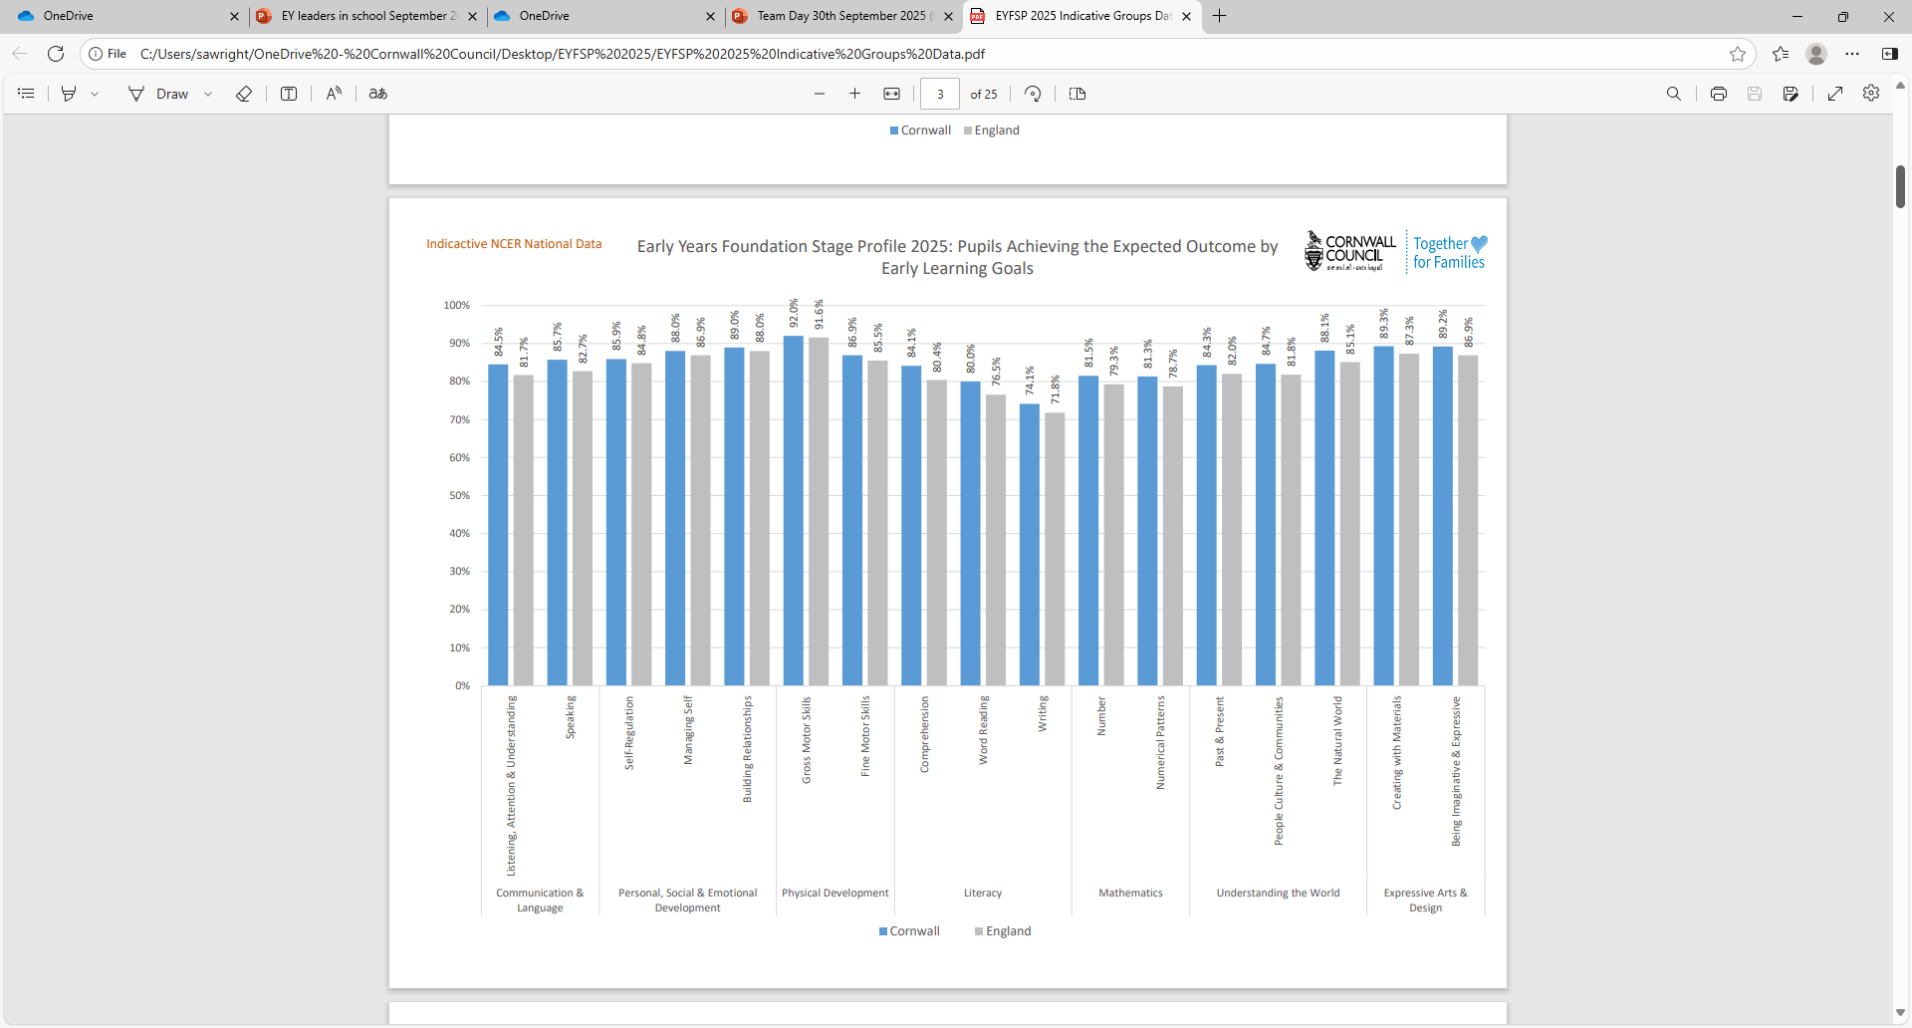

Slide 26
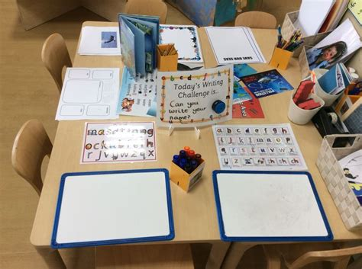
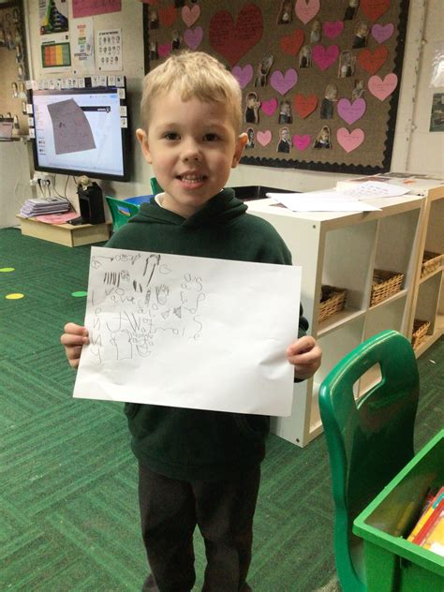
Writing outcomes
Discussion-
The Writing ELG remains the goal which fewest children achieve.
What is working well in your schools?
What is making a difference?
What could we share that might help other schools?

Slide 27
Integrated 2 year review- updates

Slide 28
Home Learning
Best Start in Life
Emphasis on home learning environments
What do you have in place in your schools to support parents around home learning?
How could you support parents further?
What activities/information could you develop across your schools to improve home learning?

Slide 29
Thank you / Meur ras
If you have any questions or comments
xxxxxxxx@cornwall.gov.uk

