Slide 1


Welcome to BLOSSOM
BLOSSOM Education
SUPPORTING TEACHERS TO MANAGE DIVERSE LEARNERS IN MAINSTREAM CLASSROOMS

Slide 2

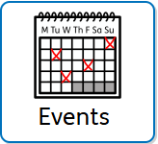

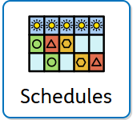
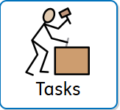

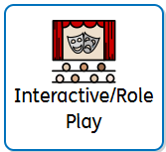


Agenda
Notes:
As you will see from the presentation today there is a big focus on little hacks that you can use as a teacher to support your learning environment. Most of us should be very familiar with the concept of a visual timetable. So here is mine for todays presentation.
1. introductions - who am I and why am I here?
2. Events - where has BLOSSOM been and where is it going?
3. Where did BLOSSOM come from? Does it sounds like your story?
4. components of BLOSSOM - schedules/coding
5. Component - scheduled tasks / what are they and how do I do this?
6. component - learning libraries - what and how?
7. EYFS special - interactive part, mics and cameras on for this part, there will be roles to play and songs to sing
8. Questions
9. Follow BLOSSOM's progress /purchase / contact me

Slide 3

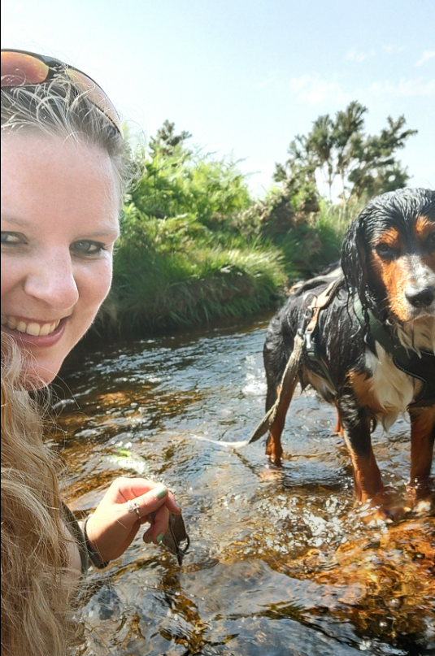


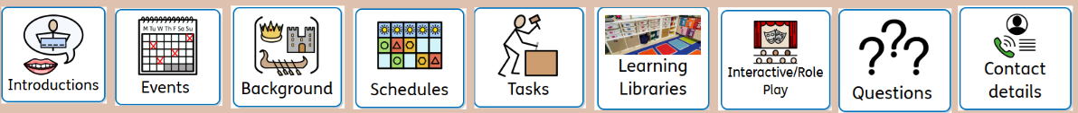
Anna Rowe
EYFS Lead
Full time EYFS Teacher
Primary Qualified
Sport Specialism
Passion for SEND
Training SENDCo

Slide 4






Bright Start Conference
The 2025 Bright Start International Conference is more than just an event—it's a global movement dedicated to advancing early childhood & primary education for children aged 0–8 years through collaboration, innovation, and shared expertise. This year, we are expanding our reach like never before, hosting the conference simultaneously in two major cities—London, United Kingdom, and Abu Dhabi, United Arab Emirates—while also live-streaming worldwide!
I am presenting in London in November 2025 broadcast globally.
Find out more
https://conferencebrightstartfoundation.org/
EP 20- SEND in Mainstream EYFS with Specialist Anna | Podcast Episode on RSS.com

Slide 5

Agenda
Notes:
No response needed but just have a little think to yourself.
Did you have any moment where your stomach dropped? Did you think about how to get out of it? Quickly thinking I will say my mic isn't working etc.....
That is us as adults who can regulate and something made us anxious and we don't want it to happen. Added with me crossing out the timetable as we go.
This isn't to go against whole class timetables, it is merely a thought provoking point - some children will not cope knowing something is happening in the day that they don't enjoy

Slide 6

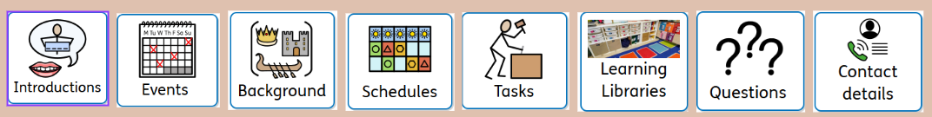
Background
Feeling lost led me here.....
The inclusion of children with Special Educational Needs and Disabilities (SEND) within mainstream classrooms is an integral part of the UK education system’s commitment to diversity and inclusion.
However, as the number of children entering mainstream with high need SEND rises, many teachers are finding themselves increasingly challenged. Often, these teachers are expected to deliver quality education to students with complex needs without the necessary funding, resources, or adult support that are critical for success.
Notes:
Staff well-being is adversely affected as educators feel compelled to address the individual needs of each learner. The guilt that teachers impose on themselves is significant; it often leads to a pervasive sense of inadequacy, as it is challenging to meet the diverse needs of all students while navigating a chaotic and stressful environment.

Slide 7






Key Challenges for mainstream teachers
Meeting Multiple Diverse Needs
Communication Barriers
Resource Limitations
Many teachers face insufficient resources to support diverse learning needs effectively. This is NOT the fault of schools or leadership, it is the state we find finances in education.
Understanding Student Variability
Engaging All Students
Teachers must adapt to a range of learning styles.
Effective communication is crucial for successful classroom interaction. More and more complex communication needs are entering our classrooms

Slide 8



Slide 9
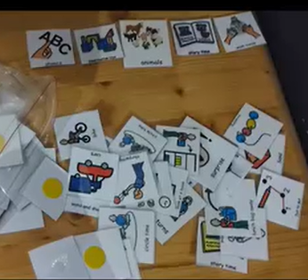



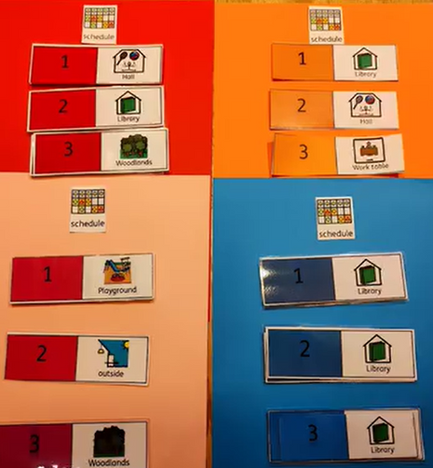
From This
BUILDING LEARNING OPPORTUNITIES TO SUPPORT STUDENTS WITH SEND ON MAINSTREAM CURRICULUMS.
Component one:
Schedule visuals
BLOSSOM Education uses a reduced amount of visuals to support the consistent use of a visual environment.
When you are expected to support a child with individual now and next visuals without additional adult support keeping the visuals manageable is KEY!
To This

Slide 10





Visual Classroom hints
Location
Minimal
Organisation
Using location visuals rather than subjects to reduce anxiety and keep learning personalised.
Using less visuals will enable that staff can remain consistent in using them for pupils.
Keep a masters file easily accessible with multiple copies of each visual.

Slide 11
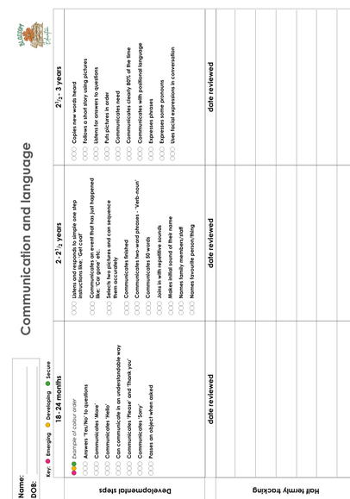
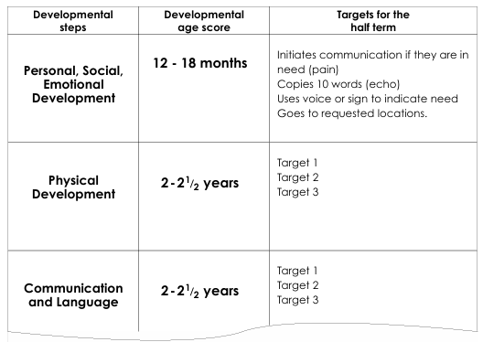
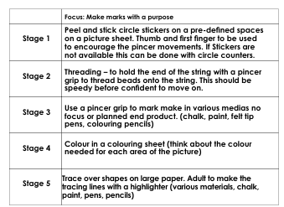
BUILDING LEARNING OPPORTUNITIES TO SUPPORT STUDENTS WITH SEND ON MAINSTREAM CURRICULUMS.
Component two:
Scheduled tasks
BLOSSOM Education allows for planning that reflects the child’s individual targets to be accessed and delivered within the mainstream classroom.
Using the developmental tracker sheets from the BLOSSOM resource can track small steps of progress over time.
Schedules are planned over 4-6 week blocks reducing weekly workload for staff

Slide 12



Scheduled Tasks
Keep it simple
Repetitive
Reduced weekly planning
Ensuring the steps are small and simple to maintain engagement in the activity
Support the reduction of anxiety and working memory by repeating the step multiple times to ensure the child is competent at the skill.
Carefully planned scheduled tasks leads to less weekly planning required by staff. Just adjustments.

Slide 13
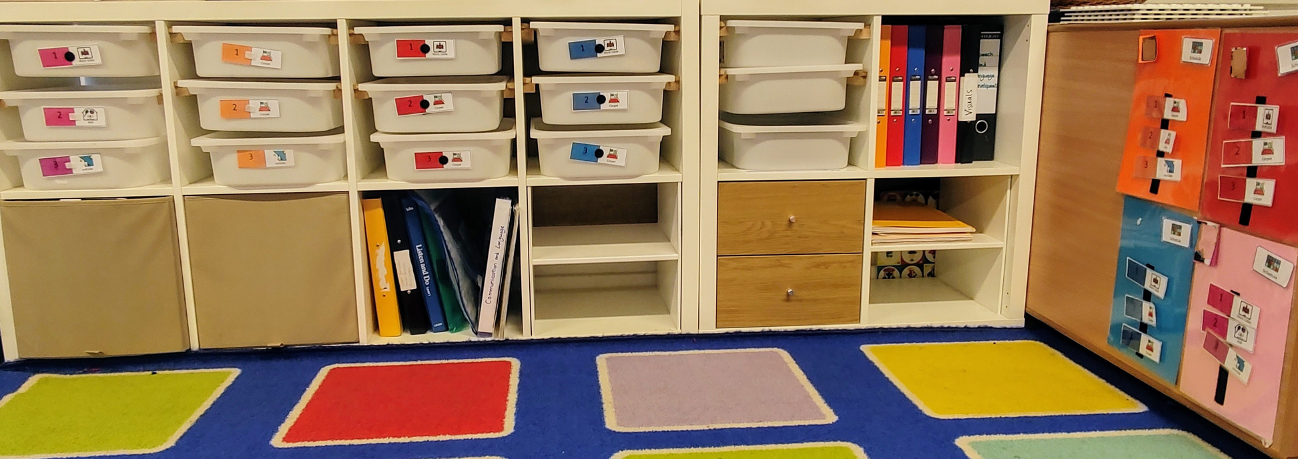
BUILDING LEARNING OPPORTUNITIES TO SUPPORT STUDENTS WITH SEND ON MAINSTREAM CURRICULUMS.
Component Three:
Learning Libary
BLOSSOM Education centers around the classroom set up of a “learning library”. This organisation enables pupils to maintain a sense of control and ownership to their area.
Staff report it to be accessible to use and manageable to maintain.
Calm, structured and organised the learning library reduces workload for staff in the long term.

Slide 14

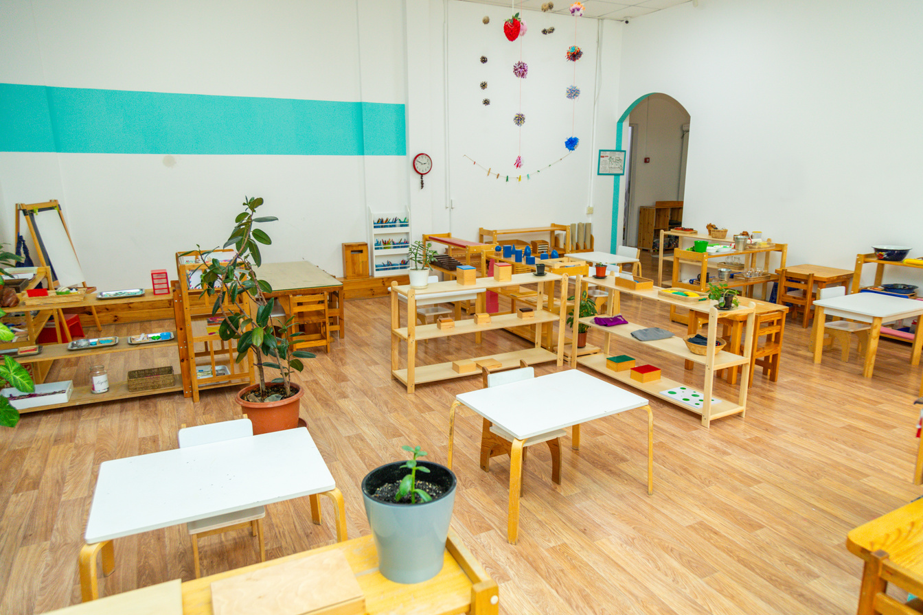

Key take aways
Visual
Coded resources
Organised
To increase independence all learning libraries must be visual and accessible. They are as much a part of the room as table and chairs.
Students areas must be coded to help independence. This could be through colour, picture, shape .
Keeping the library organised and tidy will limit the time it takes to reset each day

Slide 15

Questions?

Slide 16

BLOSSOM Education
Building Learning Opportunities to Support Students with send on mainstream curriculums.
BLOSSOM was created to relieve the stress and pressure that mainstream teachers place on themselves when supporting the education and development of high need SEND pupils, often with limited support.
It is current in school around the UK, from large city schools in London to smaller school in Scotland.
BLOSSOM Education resource file can be purchased directly through the author.

Slide 17


SOCIALS
BlossomEducation_play2learn
Contact Information
Please reach out if you want to know more!
EMAIL
anna_active_eyfs@hotmail.com

