Slide 1
CODE Maths Hub

Slide 2
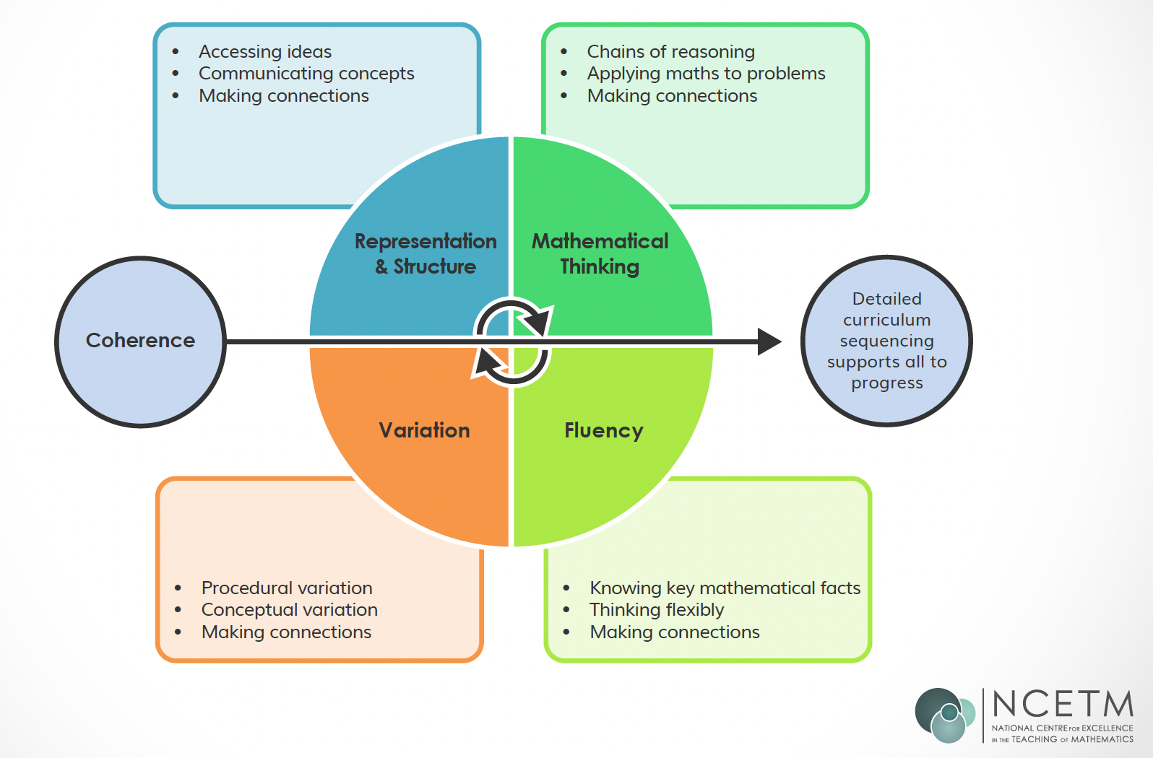

Slide 3
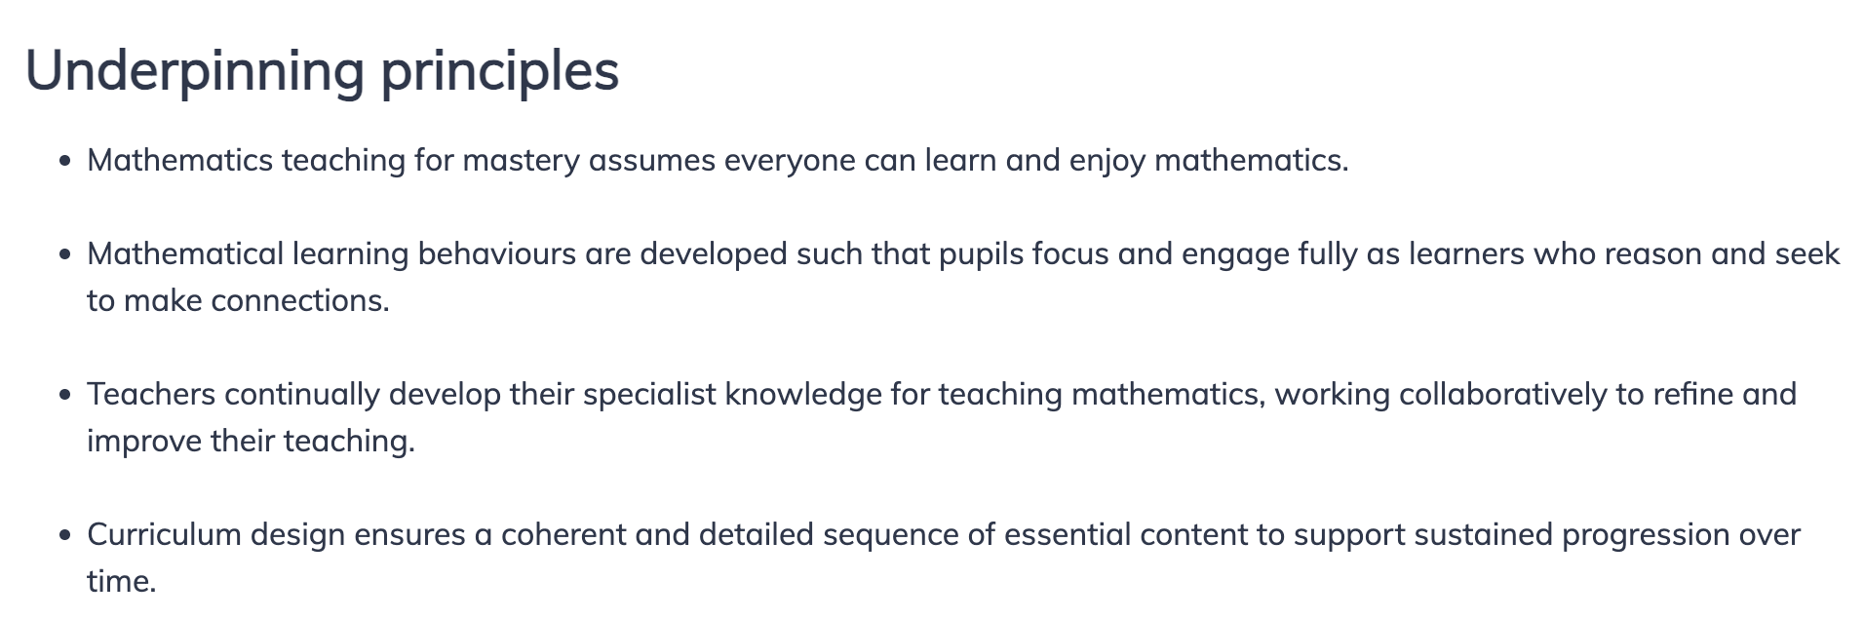

Slide 4

LLME x 55

Slide 5






Slide 6
“The first 20%” – Adaptive teaching, Inclusion by design
Adaptive toolkit
Understand Ofsted Framework through this lens.

