Slide 1

Peer Neighbourhoods
Experts @ Hand
21 April 2026
SEND Reform Planning
Notes:
4 mins:
Jen / Matt – welcome and purpose - intros

Slide 2

What do we want Experts at Hand to look like in Cornwall?
Notes:
1 min
Jen / Matt will represent schools at a planning meeting of commissioners and providers to help shape the Experts at Hand Offer. The output of this session will contribute to that work. Cat Scutt, Emma and Kate (CAPH and CASH) also invited

Slide 3

Cornwall’s SEND system spans a large and diverse education landscape across phases and settings
236 primary schools
31 secondary schools (12 with sixth forms)
472 Early Years providers
6 Alternative Provision Academies including 1 hospital school
5 Special Schools with satellites
6 Independent schools
8 Independent special schools
Primary – 82% academies/18% maintained
Secondary – 84% academies/16% maintained
Overall – 82% academies/18% maintained
Notes:
1 min
Jen / Matt
This is the logo that represents the whole system not just an NHS logo

Slide 4
Health provision is complex across providers, so integrated planning matters for families’ experience
Three hospitals plus close working relationships with tertiary hospital in Bristol
  Royal Cornwall Hospital Trust delivers to the majority based of acute need, with some community provision.
  University Plymouth Hospital Trust working with children, young people and families in the east of the county
  North Devon Hospital, managing some children in the north-east of the county.
Tier Four Hospital – Sowenna
One Community Trust, managing mental health and community services, including neurodevelopmental pathway and community nursing.
However, some community provision, including paediatrics and therapies also managed in hospital trusts.
One Urgent Treatment Centre
10 Minor Injury Units (Bodmin, Bude, Camborne / Redruth, Falmouth, Helston, Launceston, Liskeard, Newquay, St Austell, and the Isles of Scilly)
15 Integrated Neighbourhood Areas in Cornwall (clustering some PCNs), at various stages of development, with ambitious plans to roll out CYP MDTs across the next 2 years.
Notes:
1 min

Slide 5
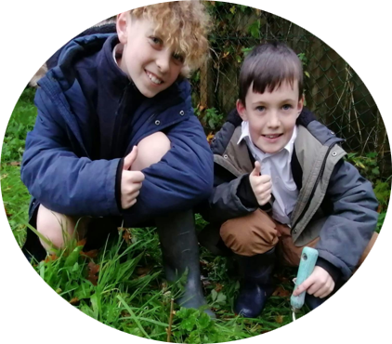
Cornwall
Behind every improvement is a child’s experience getting better, earlier and closer to home
Community
Campus
Curriculum
Children / Families
Notes:
1 min
Jen / Matt

Slide 6
SEND Centres of Excellence has given us a true head start on SEND Reform Planning
Ordinarily Available Provision
Mid Cornwall Sufficiency Planning
Inclusion Charter
Peer Partnerships – including working with the NHS and experts at hand
Experts at Hand: Core Expectations
Clear delivery model with strong performance management
Decisions shaped by partners and local need
Integrated with existing SEND, health and AP services
Improved access to specialist expertise
Robust governance with a named SRO
Fair and consistent access for all settings
Notes:
1 min
RD

Slide 7

Notes:
1 min
RD

Slide 8



















SEND Reform – The school cluster & what gets better for children
Needs or developmental delays are identified early and supported within weeks. Children arrive at Reception ready to learn, with support already in place. Families no longer need to fight for legally-binding support when school starts.
EARLY YEARS
The school cluster
becomes the village that raises the child
Adjustment of support is flexible and responsive but rooted in preparation for adulthood. Inclusion bases mean children learn close to home and can see friends after school. A network of experts prepares more children for mainstream secondary.
ICB
Expert at Hand
PRIMARY
Expert at Hand
Local authority
Parent/Carer Forum
Primary school
Primary school
Transition to secondary is smooth and local. Children become young adults by learning skills that prepare them for life beyond school. Support is provided but underpinned by achievement and independence. Exclusions & suspensions reduce.
Family Hub
Secondary school
Independent special school
SECONDARY
Primary school
Family Hub
Special school
More young people enter education, employment or training. Support shifts from adapting the environment to adapting to the environment. Adulthood is a well-prepared step forward, rather than a cliff-edge.
Primary school
Expert at Hand
POST-16
Expert at Hand
ADULTHOOD
Notes:
1 min
RD

Slide 9
What is Available?
A whole alphabet ……..
PINS - Partnerships for Inclusion of Neurodiversity in Schools
MHST - Mental Health Support Teams
SENDSS – SEND Support Services
EY SEND – Early Years
AiST – Autism in Schools
DCTS – Disabled Childrens Therapy Service
SCiP – Supporting Change in Practice
SaLT CC (Speech & Language)
SaLT NHS
VCSE - Voluntary, Community and Social Enterprise
Headstart - Prevents mental health escalation
EP Service – Educational Psychology
Healthy Child Programme
School Nurse Service
NHS Therapy Services
Notes:
2 mins
Jen / Matt – all to contribute

Slide 10
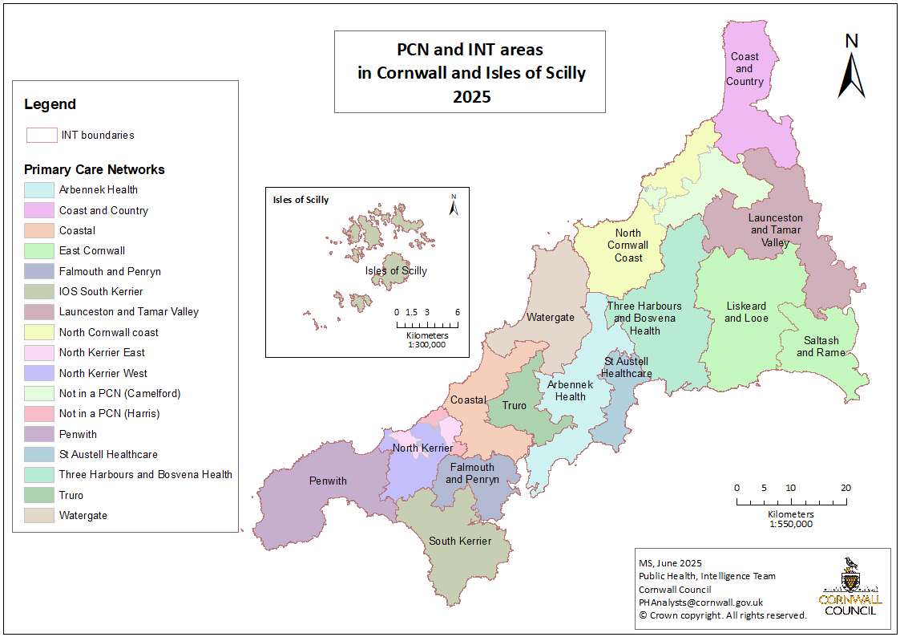
Neighbourhood
Health
Networks
Notes:
3 mins
Rochelle Bones – mapping peer partnerships against the Primary Care Networks

Slide 11
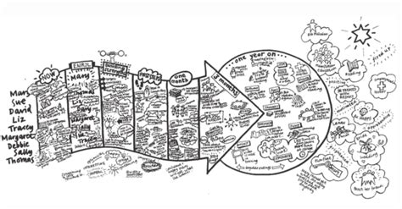
Case Study- EPs and an Experts at Hand Offer
How might Educational Psychologists be deployed more effectively?
What do schools and settings already value from EPs?
What do we want to take forward into the Experts at Hand model and what should we leave behind?
How could we work more effectively to have a greater impact with more CYP?
Where does each community want to be in 3 years time?
And in 10 years......
Notes:
3 mins
EP Service – Hannah Fugill
Providing in school advice and guidance to improve classroom practice, upskill teaching and support staff and maintain a skilled workforce. Opportunity to ask ourselves at a county level and at a local community level what we want a new model to look like to create inclusive education spaces for all our CYP. Settings used to working with EPs but time has been in short supply and inevitably directed at the top of the triangle.
Work with a community of schools / settings to create a shared vision for their own Experts at Hand Offer

Slide 12
What do we need?
Notes:
Jen / Matt – all to contribute

Slide 13
Specialist
Targeted
Universal
Planning for Predictable Needs
How do schools currently maximise element 3 funding?
CPD
Staffing
E@H is for
Universal and Targeted:
Advice
CPD
Whole School Strategies
Notes:
5 mins
Jen / Matt

Slide 14
Understanding What We Need
Room 1
Which needs would benefit most from “expert at hand” support rather than referral escalation?
What should never sit within an Experts at Hand offer?
Room 3
Which decisions truly require specialist or clinical expertise?
What decisions could be safely supported by expert advice rather than assessment?
Where are schools currently asking for diagnosis when they are actually seeking reassurance, strategies or confidence?
Room 2
What does AP involvement look like?
What does Special School Involvement look like?
Notes:
2 mins to set up
10 mins in breakout rooms
Jen / Matt – all to contribute

Slide 15
Understanding What We Need
Room 1
Which needs would benefit most from “expert at hand” support rather than referral escalation?
What should never sit within an Experts at Hand offer?
Claire Heron
Dan Morrow
Helen Salmon
Theresa Maunder
Dee Hudson-Vaux
Mark Corbett
Hannah Tallis
Jennifer Blunden
Dilys Vincent
Rosie Thomas-Easton
Notes:
5 mins
Feedback

Slide 16
Understanding What We Need
Room 2
What does AP involvement look like?
What does Special School Involvement look like?
Sue McDermott
Guy Chappell
Emma Kerr
Jonathan Stocker
Christian Denley
Samantha Anderson-Parker
Lucy Yeomans
Audrey Goreham
Nick Millward
Notes:
5 mins
Feedback

Slide 17
Understanding What We Need
Room 3
Which decisions truly require specialist or clinical expertise?
What decisions could be safely supported by expert advice rather than assessment?
Where are schools currently asking for diagnosis when they are actually seeking reassurance, strategies or confidence?
Nick Foxwell
Laura Read
Kate Littledyke
Hannah Fugill
Matt Middlemore
Tryphaena Doyle
Graeme Plunkett
Rochelle Bones
Jodie Pethick
Dafna Bicaci
Notes:
5 mins
Feedback

Slide 18
Workshop Dates – Face to Face:
30th April 13:00-16:30
Ordinarily Available Provision
Amy Daniels / Tanya Banks
7th May 09:30-14:00
Experts at Hand
Liz Cahill / Rochelle Bones
Notes:
5 mins Jen / Matt – summarise
Jen and Mat will represent schools at a planning meeting of commissioners and providers to help shape the Experts at Hand Offer. The output of this session will contribute to that work. Cat Scutt, Emma and Kate (CAPH and CASH) also invited

Slide 19
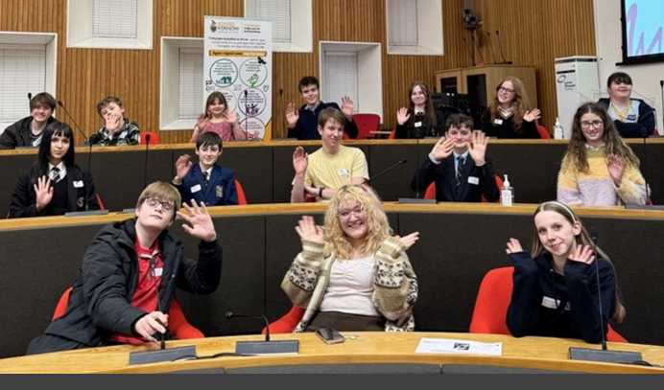


Thank you | Meur ras dhisowgh

