Slide 1
Sufficiency Planning/ Numbers on Roll in Cornish Primary Schools
Pete Batten, Education & Early Years Sufficiency Manager
Sarah Lewis, School Admissions Manager

Slide 2
Aim of today’s session
Understand what is happening with Primary numbers on roll in Cornwall
Confirm what analysis is available to inform schools
Review what schools can do
Answer the question: How do I reduce my Published Admission Number (PAN)?

Slide 3
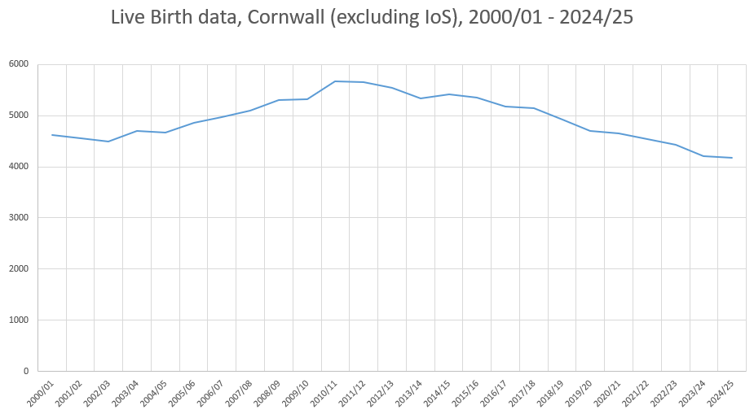
Live births in Cornwall
25% drop
Notes:
The big driver behind falling rolls in Cornwall has been falling live births over the last 15 years…but this is not unique to Cornwall.
Globally, countries are seeing fertility rates drop to new lows each year. Countries need a total fertility rate of 2.1 (i.e., average number of children born to each woman of child-bearing age) in order to maintain a stable population. Almost all countries globally have rates below 2 (the only continent where this isn’t yet true is Africa, though it is projected to fall below 2 in the near future). The UK is currently just under 1.5 (having been close to 2 as recently as 2010). Some countries with extremely low TFRs include Italy, Japan and South Korea – in fact, South Korea’s TFR is below 1, with some quite shocking implications around the future viability of major towns away from Seoul. Things in the UK aren’t that bad…YET (but some think it is only a matter of time).
Trough in early 2000s, peak in early 2010s (corresponding to a rise in TFR to just under 2 nationally) before steady decline in live births which has coincided with a fall in TFR, i.e., there were plenty of people around to have more children than were born – this is about society in general choosing to have fewer children than has previously occurred.
25% drop since 2010/11 and 2011/12.
Numbers have appeared to stabilise in the last 12 months, though this has happened twice before (2014/15 and 2017/18) only for declines to continue. In the most recent data, what is interesting to find is that around half of all CNAs saw a fall in live births compared to 2023/24, and the other half of CNAs saw an increase. The biggest declines observed were bigger than the biggest increases. This highlights that there is still likely a downward pressure on live births in Cornwall, though there are clearly pockets where the situation is turning around.

Slide 4
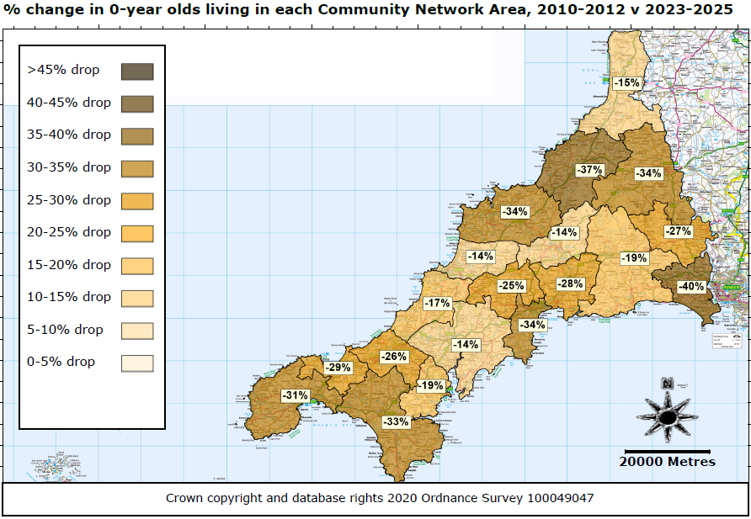
Live birth changes not evenly spread
Notes:
This map looks at changes between 2010/11 and 2011/12 to 2023/24 and 2024/25. Live births can be volatile, so comparing 2 years of data (at the peak) and the most recent 2 years can help to smooth out some of that volatility and give a clearer picture as to what has been happening
Pick out the East/North East Cornwall decline, the St Austell decline, and the West Cornwall decline – it is perhaps unsurprising that the areas that have faired better are areas of high employment and/or tourism. The Bude area stands out in North Cornwall, and is likely being driven by recent significant housing in the area along with employment opportunities through GCHQ.
Generally speaking (Launceston and Camborne/Redruth have faired less well than expected) shallower declines have happened where new housing has taken place, which has attracted more people to live which in turn has led to an increase in families in these areas and therefore a bump in live birth numbers. Areas with low levels of new housing have generally been unable to attract new/younger families to the area (either because of a lack of housing or lack of local employment, or both), which has given rise to a more rapid decline in live births.

Slide 5
What about migration?
Cornwall’s 0-15 population has been stable for the last 10 years
Net inward migration amongst 0-15 year olds has been over 1,000 since 2016/17
Current migration levels are no longer high enough to sustain a stable 0-15 population
Notes:
Aren’t we building loads of new homes? Isn’t that attracting loads of families in that will counteract the falling live births? Answer: Yes and No
Despite what we’ve just seen, Cornwall’s 0-15 population has remained between 93,000 and 95,000 since 2014/15
As live births have fallen, migration has helped to keep overall pupil numbers up
In fact, if you compare the number of 0-14 year olds in a given year with the number of 1-15 year olds in the following year to see how this specific cohort has changed in 12 months, we find that since 2016/17-2017/18, Cornwall has had an annual net increase of 1,400 children through migration. 2022/23 was a particularly high year with over 2,000 more children entering Cornwall than leaving.
For context, Cornwall actually lost children in 2015/16 (compared to 2014/15) and the following year net inward migration was under 300.
When you combine the falling live births data with the average migration we’ve seen over the past decade, the picture we get is one of a shrinking overall 0-15 population in Cornwall – best case scenario, the population drops to just under 90,000. If live births remain at around 4,000 per year for a sustained period of time, the 0-15 population in Cornwall could drop below 80,000 by 2035.
As with the previous slide, there are also differences in migration levels between areas, with areas like Truro, Bude, St Agnes/Perranporth having some of the highest levels of net migration observed since 2016/17.
New housing is linked to migration – more housing built often leads to higher levels of migration amongst children (though this also depends heavily on the type of housing built as well as the demographics of people moving into those new houses).

Slide 6
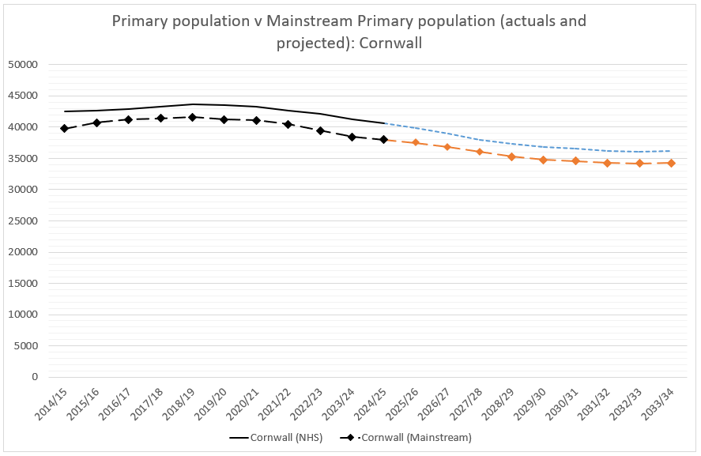
Primary population/mainstream numbers:
Cornwall
Notes:
WHEN YOU PUT ALL OF THESE FACTORS TOGETHER (FALLING LIVE BIRTHS PLUS NET INWARD MIGRATION) YOU GET THE FOLLOWING PROFILE
Primary population peaked in 2018/19 at just over 43,600 primary aged children in Cornwall
This coincided with a peak Primary mainstream population of 41,600
Roughly speaking, about 95% of the primary age population are in mainstream – though there is some variation from one year to the next
Figures during COVID were actually robust – Autumn 2023 and Autumn 2024 actually saw lower than historic rates (just over 93%) in mainstream which has led to lower than expected Primary cohorts. This is likely linked to significant increases in children with EHCPs, and more and more mainstream schools being unable to meet the needs of some of these children.
As of Autumn 2024, Primary mainstream cohort was down to under 38,500. I haven’t seen Autumn 2025 census data, but am expecting a figure below 38,000 given that we had just 5,000 Reception children start mainstream this term (while over 6,000 left Year 6 in the summer term).
It is projected to fall further (in line with falling primary population) to just 36,000 by September 2028. These projections assume 95% of primary aged children will be in mainstream; if the recent lower rate (under 94%) continues, the primary mainstream population will be lower still.
The NHS projections for the Primary population overall assume that migration levels continue at their current levels AND assume live births return to 4,500 per year by 2035 (up from 4,200 in 2023/24 and 2024/25). If live births recover more quickly, the primary population will recover more quickly; equally, further deterioration in live births will cause future primary populations to decrease further.
Assuming the above happens, the overall Primary population will stabilise at around 36,200, with mainstream Primary population in Cornwall stabilising at around 34,000-34,500 – this is over 7,000 fewer children in our Primary schools compared to 2018/19!

Slide 7

Information on school level forecasts
corestats@cornwall.gov.uk
Notes:
Where can I find more information about my own school forecasts?
Answer: CoreStats
Only available to schools that have purchased the Data & Statistics SLA (though historically this has been almost all Primary schools in Cornwall). Whilst we are happy to have discussions with any schools about pupil projections, we are unable to share the school level analysis that our Data & Statistics team creates with schools that haven’t signed up to the SLA.
Current available analysis (from Feb 2025) shows forecasts up to September 2028 (2028/29)
Includes school catchment data giving schools a clear indication of the number of children by age living in the immediate vicinity of the school.
Also includes details of known new housing developments that are most likely to affect your school over the next 5 years
Includes historic data on NOR so you can see how your school’s NOR has evolved over the last 5 years (particularly useful for newer heads)
Also includes additional forecast graphs, showing the data in a different format as well as showing PAN capacity v actual/projected NOR for the wider Community Network Area the school is located in
I’ve included an email for the CoreStats team on this slide, should you wish to contact the Data team about getting access/where to find your analysis on CoreStats.

Slide 8
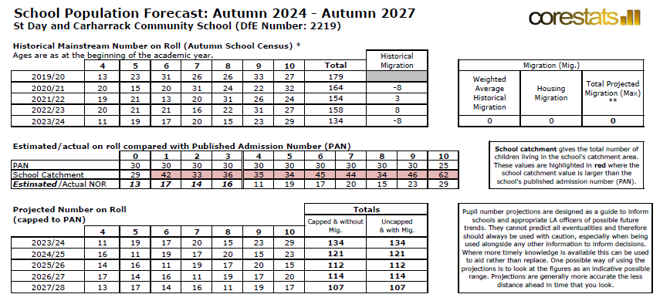
Falling rolls – impact on my school
Notes:
Example of a ‘Falling Rolls’ school
Highlight large school catchment – this school has enough children living locally. The problem is parental choice has led to many parents opting to send their children to a school in the nearby town.
Notice how this has actually been happening gradually since 2019/20 – for the last few years, a number of Primary schools have already begun to see declining numbers on roll but have chosen to ignore forecasts and hold out hope that the falling numbers on roll are temporary and simply a consequence of the school going through a tough patch. Schools need to reflect on whether falling rolls is down to demographics or parental choice (or a bit of both) – but ultimately, schools need to plan ahead based on what is likely to happen (rather than what they hope might happen).
Interestingly, this school actually has plenty of children living in its own catchment area to more than fill the school (i.e., demand is greater than supply). However, parental choice is drawing large numbers to other schools in the area. As more places become available in other schools (due to falling rolls) the most popular schools fill up first, leaving less popular, or more rural schools taking fewer and fewer children.
[Point out Historic NOR falling, school catchment figures, flat migration – no new housing in this case/past trends don’t point to net inward movement to school, overall total NOR set to fall over the next years]
This school would have likely been operating 7 classes back in 2019/20. How many classes do you think this school should be operating in 2027/28 given a NOR projection of 107? Answer: Certainly not 7! Though not as simple to determine what the optimal number would be, given the distribution of children by age across the school, and the fact that the school is still operating with a PAN of 30!?

Slide 9
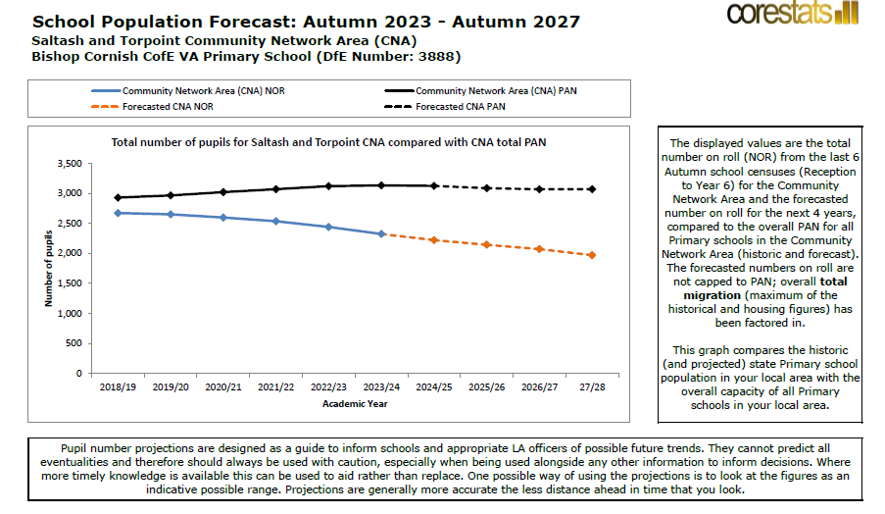
Falling rolls – impact on my school
Notes:
In addition to the main forecasting documents, there is a forecasting ‘graph’ document.
This helps to underline the recent changes in the size of school cohorts in both the county and across your own local area.
In particular each school should have a page showing the total ‘capacity’ of all primary/secondary schools in the local area, and the corresponding current NOR and projected NOR. This again helps to put the school’s own projected numbers in context. Your school may not have indicative falling rolls projections, but your area may none the less show larger capacity compared to projections, indicating that other schools in your local area may be projected to suffer from falling rolls. With changes to school popularity, it may not take much for your school to suddenly find itself in a position where intakes are falling, or more children are leaving your school to join other local schools due to preference. It is good to be aware of these trends and therefore that there may still be a risk of falling rolls impacting your school in future years. This underlines the importance for schools to talk to one another.

Slide 10
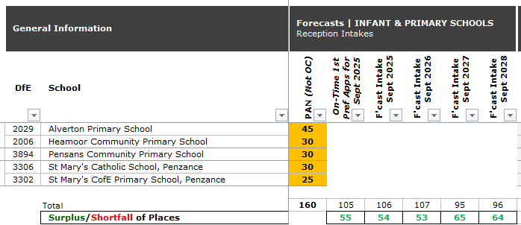
Example PANs v Forecasts:
Penzance TOWN Primary Planning Area
Notes:
Earlier this term we ran some ‘PAN Review’ sessions for schools across Cornwall who we thought might be most likely to consider a PAN reduction.
These sessions included some of what you’ve heard today, but also a more in-depth look at specific geographic areas (based on the schools attending). We hope to run similar sessions in future to support schools in making informed decisions about their school. As you can see in this example, this includes sharing data at a planning area showing how school Reception forecasts for an area compare with the PANs currently in place across schools, helping to highlight some of the particularly large discrepancies we have currently and helping to support schools to make difficult decisions around PAN reductions in particular.

Slide 11
What schools can do
Don’t panic
Set budgets using realistic pupil numbers
Talk to other local schools
Consider PAN reductions
Consider class restructures

Slide 12
How do I change my school’s PAN?
A school’s Admission Authority is responsible for carrying out statutory consultation to reduce the Published Admission Number (PAN) (C/VC schools = Cornwall Council, academies = academy trust, trust/VA schools = governing board).
PANs are set annually as part of a school’s wider admission arrangements.
Next opportunity to make a change: for 2027/28 arrangements which must be determined by 28 February 2026.
Consultation for at least six weeks between 1 October 2025 and 31 January 2026.
Consultees are listed in the School Admissions Code – and guidance is available from the School Admissions Team.
Notes:
NB: Failure to consult effectively may be grounds for subsequent complaints and appeals.
OSA advice: good consultation – whether by local authorities or schools – uses a number of different ways to reach those who may have an interest. It will include a prominent and simple message on the front page of the relevant website, backed up with more detailed information and use of print and social media.
Already-determined PAN (if questioned):
PANs that have been determined can only be changed if a formal request for a variation is agreed.

Slide 13
PAN: things to remember
The PAN, once set for a particular year of entry, is binding.
The PAN only applies to the year of entry (i.e. reception in a primary school).
The PAN applies for the whole of the year of entry, you can’t restrict numbers below the PAN.
You can admit over PAN if you want to.
A suitable PAN gives you flexibility and helps you plan better.
Other year groups have what we call an ‘Admission Number’ which is not binding. It’s important that schools let us know the capacity for all their year groups so these can be reflected in Synergy SAM and so that we have accurate information about the number of places available.
It’s also really important that schools regularly update their attendance counts in Synergy SAM and let us know about class organisation changes.
Unsure about anything? See the Admissions area in the Schools Platform or if you can’t find what you need there, email schooladmissions@cornwall.gov.uk
Notes:
So, if you set a PAN of 20 but get 30 pupils eligible for a place you can accept 30 and have a full year group move up through the school. Equally if you set a PAN of 60 and get 38 pupils eligible for a place you can’t restrict this to 30 to avoid having to run a second class.
For example, if your PAN is 30 for a Reception intake, but you only have 22 Reception children join at the start of the academic year, you would still be expected to take up to a further 8 Reception children, if required, during the academic year that these children are in Reception.

Slide 14

Questions?

Slide 15
Thank you / Meur ras
If you have any questions or comments
peter.batten@cornwall.gov.uk
sarah.lewis@cornwall.gov.uk

