Slide 1

Safeguarding Reference Group Update

Slide 2
You Said → We did
Section 157/175 – is it having a positive impact on safeguarding in our county?
A courageous review of how we are strengthening safeguarding practice in our county.

Slide 3

Rationale
Joined up work across the partnership
Align to our biggest challenges in county
Compliance balanced with real safeguarding
improvement and lessons learned

Slide 4
Scrutiny and Overview of Safeguarding – how will we ensure that education settings are:
Compliant with safeguarding regulations as set out in KCSIE 2026 and Working Together 2026 and Section 175 and 157 of the Education Act 2002.
Scrutinised and included in the wider safeguarding landscape in Cornwall, and implementing learning from Rapid Reviews, Learning From Experience Reviews and Multi-Agency Audits

Slide 5
1. Compliance
Section 175/157 Audit Questionnaire will be scrapped, and replaced with a letter of assurance underpinned by online and front facing online audit toolkits specifically tailored to age and stage (Early Years, School and Post-16).
As part of the Letter of Assurance that schools will be required to submit yearly, it will be expected that they undertake their own internal and partner auditing. There will also be a requirement to audit outside of own schools/trusts.
The Local Authority will continue with all of its duties and compliance, including:
Safeguarding Reviews
Regular advice and guidance and themed network sessions
Updates and signposting
Critical Friend advice and curious conversations
Training

Slide 6
Why scrap the audit?
We are in a unique and special position of trust in Cornwall currently – we have the best ever buy-in and trusting relationships between the LA and its schools and settings. The audit is not giving us the intelligence we need in order to really proactively improve safeguarding in education settings in Cornwall.
The audit only applies to schools and post-16 settings, not Early Years or any other settings. This new process will bring those settings together.
The CEP Safeguarding Leads Reference Group is the perfect conduit to roll out more meaningful and partnership-driven scrutiny.

Slide 7
2. Scrutiny and Inclusion in the Wider Safeguarding Children’s Partnership
All learning from OSCP Reviews will be collated by the LA SG Team and overseen by the CEP Safeguarding Leads Reference Group, who will devise termly themed questionnaires based on the education learning and in line with the OSCP Business Plan.
Term 1 (Autumn)
Child Sexual Abuse (including Child on Child Abuse)
Term 2 (Spring)
Children Not In School
Term 3 (Summer)
Domestic Abuse

Slide 8
Training sessions for DSLs created in line with Action Plan
Year’s Learning and actions feed into summer DSL conference
Education Action Plan
created by CEP Safeguarding Leads
Next Questionnaire released
Questionnaires complete and responses analysed by LA Education Safeguarding
Learning and Action Plan created and disseminated to schools
Action Plan fed back through CEP SG Network, DSL Network, Website
Learning and Action Plan links into section 11 audit

Slide 9
Proposal
Data informed – what have we learned as a partnership from rapid reviews and learning from practice reviews?
  What should we be implementing/changing systematically as a result?
Key questions around OSCP themes
Reflections of this in your context
Bring the outcomes to these meetings
Share our knowledge learning and next steps
Co-creating the changes/developments together

Slide 10
Expectations
Engage and share knowledge in the areas
Attend these meetings to co-construct the so what.
Trusts to assure the LA regarding safeguarding culture and compliance
Local Authority schools to work closely with the LA safeguarding team to ensure safeguarding culture and compliance
Cross trust moderation

Slide 11
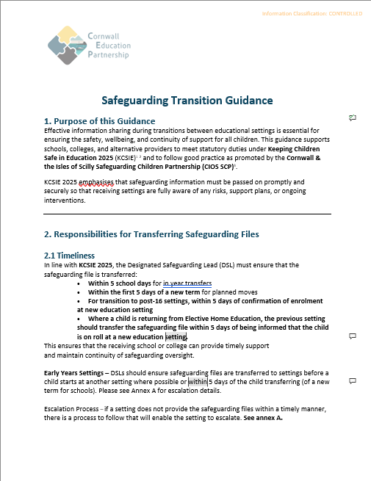
Safeguarding Transition Guidance
Strengths
Challenges
Questions
Suggestions

