Slide 1
Planning for Sufficiency, Numbers on Roll (NOR) and Reviewing PAN for 2028/29 in Cornish Primary Schools
Pete Batten, Education & Early Years Sufficiency Manager
Sarah Lewis, School Admissions Manager
Notes:
If you were here last year – this will very much act as an update.

Slide 2
Aim of today’s session
Understand what is happening with Primary numbers on roll in Cornwall
Confirm what analysis is available to inform schools
Look at what the LA is doing in relation to sufficiency
Consider what schools can do in response to falling rolls
Answer the question: How do I reduce my Published Admission Number (PAN)?

Slide 3
Live births in Cornwall
33% drop
Notes:
The big driver behind falling rolls in Cornwall has been falling live births since 2010/11…but this is not unique to Cornwall.
Couple of updates to this chart since we shared it previously
Local Public Health colleagues have provided confirmed/final live birth statistics from 2010/11 onwards, confirming (as we suspected) that live births in Cornwall peaked at just over 6,000 in 2010/11 and 2011/12.
When reviewing previous NHS live births data for 2000-2016, there was a clear 6% underreporting between 2010 and 2016 of the 0-year old population compared to actual NHS live births. We have therefore been able to go back and estimate actual live births for 2000-2010, which suggests that live births in Cornwall didn’t drop below 4,700 during the 2000s.
The latest NHS 0-year old population (for 2025/26) was 4080, suggesting a live birth figure of around 4070. This is 33% lower (not 25%) than the peaks observed in 2010/11.
It is now clear that live births in Cornwall have seen recent historic lows every year since 2019/20
Globally, countries are seeing fertility rates drop to new lows each year. Countries need a total fertility rate of 2.1 (i.e., average number of children born to each woman of child-bearing age) in order to maintain a stable population. Almost all countries globally have rates below 2 (the only continent where this isn’t yet true is Africa, though it is projected to fall below 2 in the near future).
England – 2024 it was 1.42; dropped to 1.39 in 2025 – for context, the fertility rate for Cornwall & The Isles of Scilly is currently 1.3 – interestingly, a fertility rate of 1.3 will lead to a generational population decline of 35% (i.e., the next generation will be 35% smaller than the current generation)
South Korea – only OECD country with a fertility rate below 1 – though it is now climbing (up to 0.8 from 0.75 a year ago).
Japan and Italy – 1.14 (2025)
China – 1 (as of early 2026) – China scrapped its 1-child policy, and then quietly also scrapped subsequent 2- and 3- child policies. China’s population has now shrunk 4 years running, with many commentators noting that official statistics on births in China are likely inflated too (i.e., the situation in China may be far worse than China’s data suggests)
As you can see, things are not yet as bad in the UK as they are in other parts of the world, but we are trending in that direction!
What comes next? This is the million dollar question – unless there are significant changes across wide ranging parts of society (economic growth, lower housing costs, lower childcare costs) as well as increases in social interactions, it is very likely that live births and associated fertility rates will continue to decline.
We may well see a rise in live births by 2040, as a direct result of the larger cohorts born in 2010 – however, this is likely to be a false dawn and we will quickly see further decline after 2040.
If we look at the next 5 years only, in my opinion I don’t think things are likely to change significantly (though the latest live births data suggests declines may be slowing). We may see an increase in live births in Cornwall over the next few years, but it is unlikely that any increase will be more than back to 4,400 (10% rise). What is clear is that you can’t paint the whole county with the same brush…

Slide 4
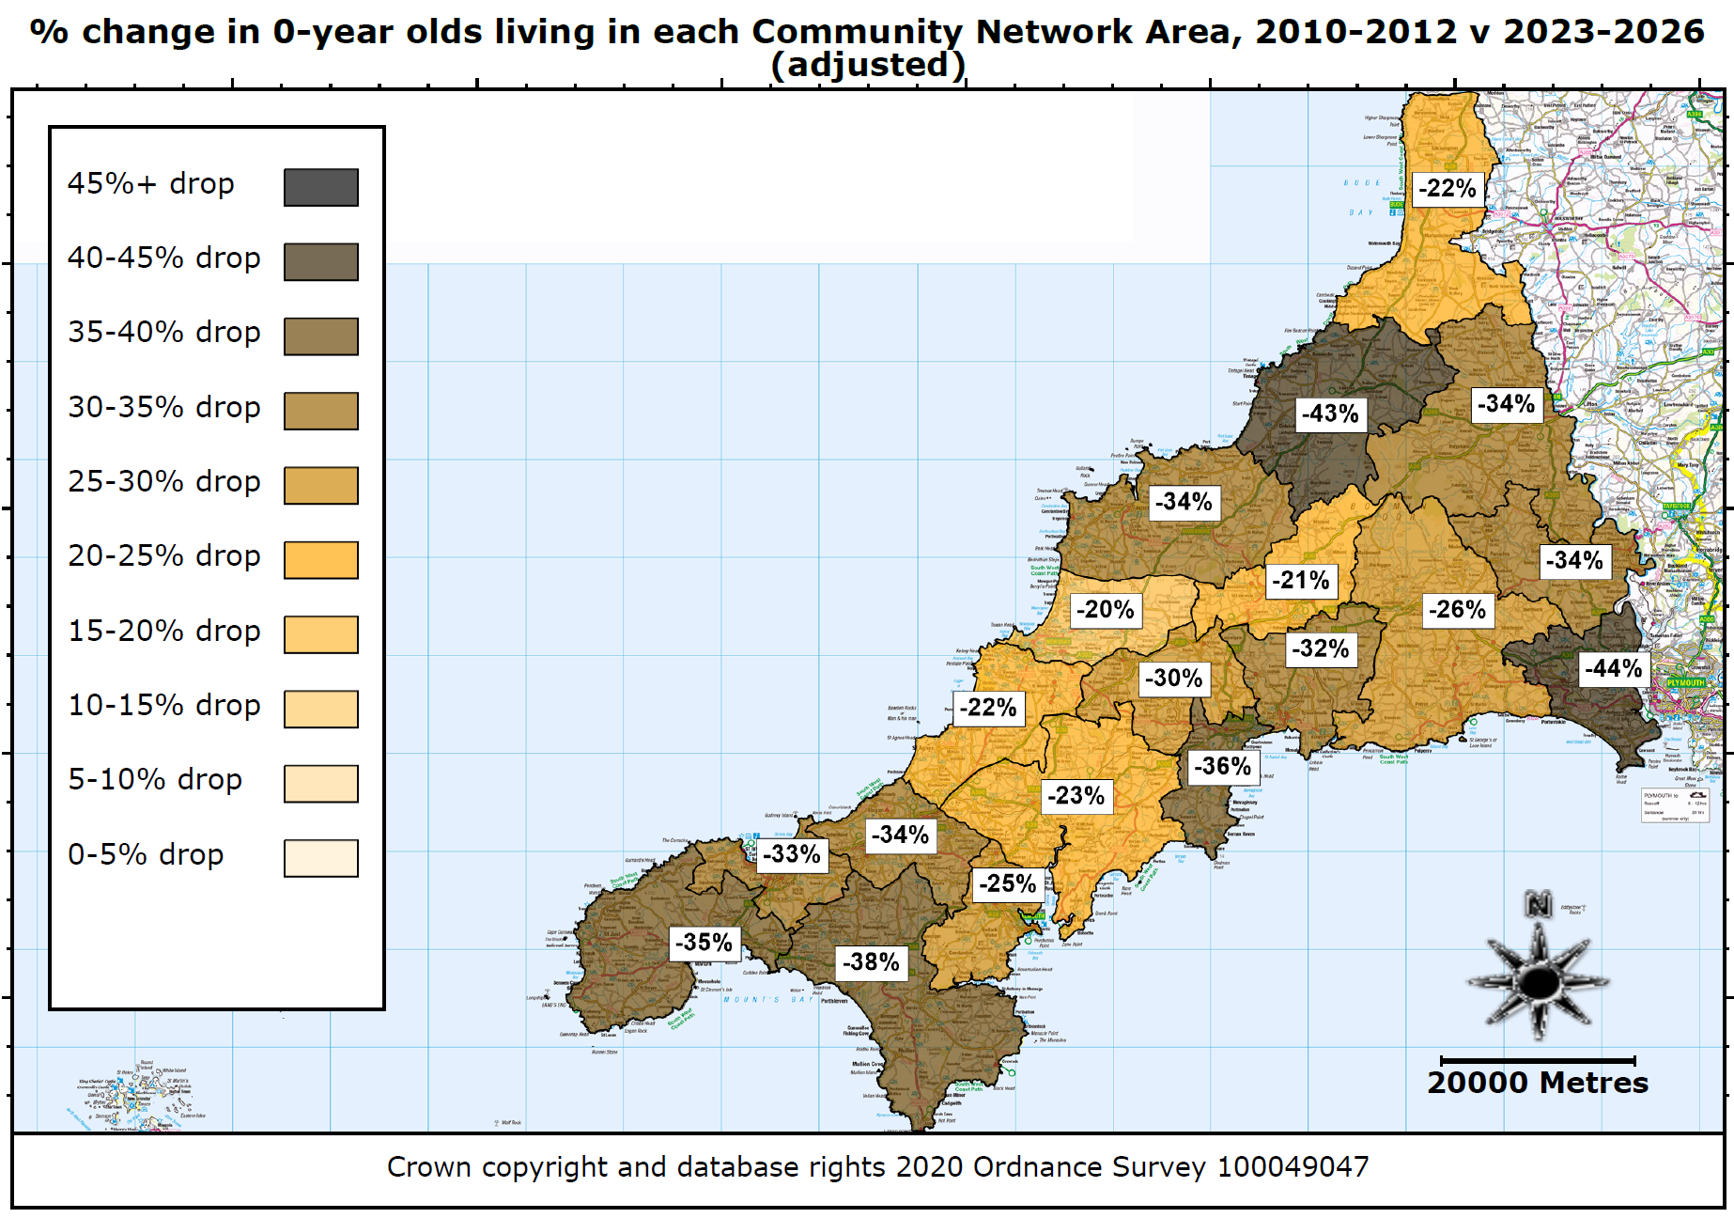
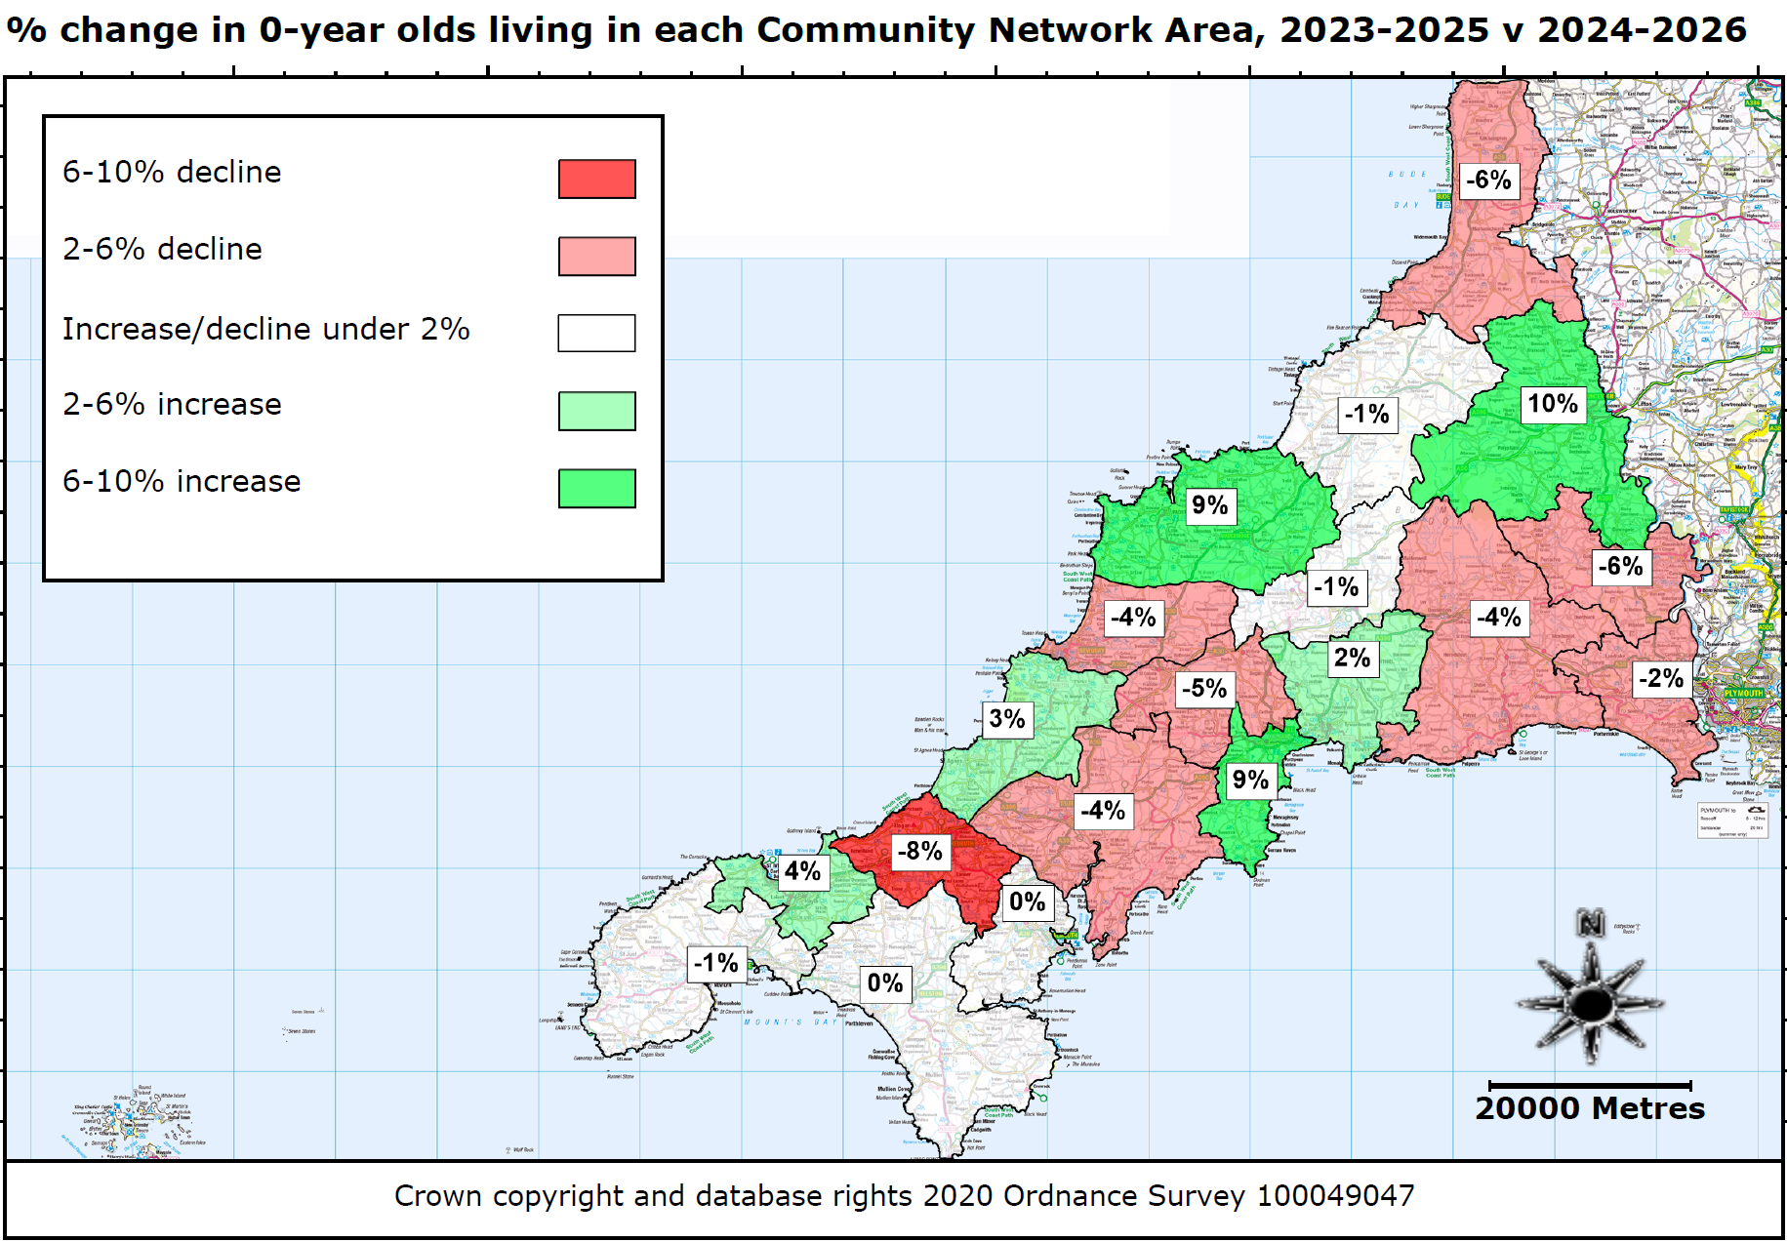
Live birth changes not evenly spread
Notes:
How have live births/0-year old populations changed across different parts of Cornwall?
Answer: Everywhere has seen a decline since 2010-2012 – but not all areas have seen the same level of decline. As has been noted previously, the peripherals of Cornwall (Eastern and Western areas) have seen greater declines, along with the St Austell area. Bude continues to stand out as a border area that has not seen the same declines as other parts of the county. In addition, central areas, particularly the Bodmin, Newquay, North coast and Truro areas have seen generally lower declines in 0-year old populations – much of this is likely to be driven by new housing and the subsequent net migration, with new families moving into these areas and starting families more so than in other parts of Cornwall.
Quick note – underlying NHS data for 2010-2012 has been adjusted to give a better representative overview of actual declines. Previous NHS data recorded 0-year old populations in 2010/11 and 2011/12 of just 5600 children; however, other public health data (supported by subsequent school census data) confirmed that live birth numbers in both years was just above 6,000 so the declines in this chart better reflect the overall 33% decline for Cornwall as a whole that we saw on the last page.
Is there any good news? What about more recent changes?
This map shows how average live births have changed from 2023-2025 to 2024-2026.
There are some green areas! St Austell, Wadebridge/Padstow and Launceston have seen increases in live births just in the last 12 months – but these need to be held in context:
Launceston: Live births jumped from just under 140 to over 160 – however, live births were over 220 (and likely closer to 240-250) back in 2010
WP: After dropping from 133 to 118, numbers rebounded to 155 in the last 12 months – however, live births were almost 200 back in 2010
St Austell: Numbers have risen from 180 to 214 over the last 3 years; however, births were around 300 per year in 2010
There are more red areas than green areas – and many of the red areas are some of the most highly populated (CPR, Truro, Newquay)
CPR recorded under 500 0-year olds in the last 12 months (down from almost 600 2 years ago); live births were around 800 in 2010
Truro is an anomaly in Cornwall: It saw a bump in 0-year olds last year (from 371 to 413) but saw births fall back sharply to 343 in the last 12 months; live births were around 500 back in 2010, highlighting the significant gap back to where births were
Still a lot of volatility overall – just 3 areas have seen YoY increases in births (out of 19) and only 6 areas had live birth numbers higher in 2025/26 than 2023/24. Areas like Truro have shown volatility in the last few years
The overall picture remains challenging – births are not recovering in most parts of Cornwall, and even where numbers are rising there is generally no evidence of strong, sustained increases in live births. The major barometer for the county should be the most populous (CPR, Truro, Falmouth/Penryn and Newquay) – given the latest trends for all 4 areas, it doesn’t look like births will be surging any time soon in Cornwall.

Slide 5
What about migration?
Cornwall’s 0-15 population has been stable for the last 10 years
Net inward migration amongst 0-15 year olds has been over 1,000 since 2016/17
Current migration levels are no longer high enough to sustain a stable 0-15 population
Net migration may be falling – which will lead to a faster decline in our 0-15 population
Notes:
Aren’t we building loads of new homes? Isn’t that attracting loads of families in that will counteract the falling live births? Answer: Yes and No
Despite what we’ve just seen, Cornwall’s 0-15 population has remained between 93,000 and 95,000 since 2014/15 - whilst live births have fallen, migration has risen, helping to offset the impact from falling live births
Current 15-year old cohorts are around 7,000 children strong; 0-year old cohorts coming in to replace them are around 4,000, meaning before net migration is factored in Cornwall’s 0-15 population is now falling 3,000 children per year
Net migration was over 2,000 in 2022/23 and has generally averaged over 1,400 since 2017/18.
What we are now beginning to see is smaller net migration (under 1,000 0-15 year olds for the last 12 months). Cornwall’s total 0-15 year old population as of 31 August 2026 was just under 91,000.
Even if migration returns to closer to 1,400 (as has been the case in the last 10 years), we are still likely to see Cornwall’s 0-15 year old population fall under 80,000 within the next 10 years. This decline WILL be swifter if net migration does not recover.
As with the previous slide, there are also differences in migration levels between areas, with areas like Truro, Bude, St Agnes/Perranporth having some of the highest levels of net migration observed since 2016/17.
New housing is linked to migration – more housing built often leads to higher levels of migration amongst children (though this also depends heavily on the type of housing built as well as the demographics of people moving into those new houses).

Slide 6
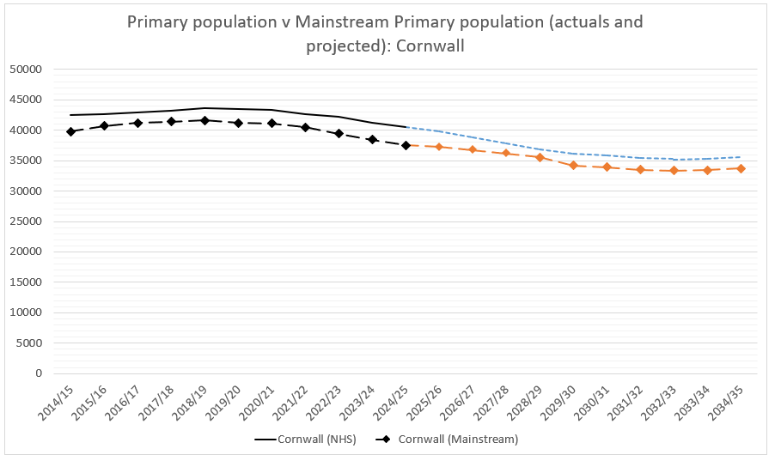
Primary population/mainstream numbers:
Cornwall
Notes:
WHEN YOU PUT ALL OF THESE FACTORS TOGETHER (FALLING LIVE BIRTHS PLUS NET INWARD MIGRATION) YOU GET THE FOLLOWING PROFILE
Solid line/blue-dashed line – actual underlying Primary aged cohort (NHS data) living in Cornwall/projected Primary aged cohort in Cornwall
Black/Orange dashed line – actual Mainstream Primary cohort on roll in Cornwall/projected Primary mainstream cohort on roll in Cornwall – first 4 years are from latest projections data; the further 6 years of projections assume mainstream cohort on roll in Cornwall will remain at 94.7% of overall expected underlying Primary cohort
Primary population peaked in 2018/19 at just over 43,600 primary aged children in Cornwall
This coincided with a peak Primary mainstream population of 41,600
Roughly speaking, about 95% of the primary age population are in mainstream – though there is some variation from one year to the next
Figures during COVID were actually robust – Autumn 2023 and Autumn 2024 still saw lower than historic rates (just over 93%) in mainstream which has led to lower than expected Primary cohorts. This is likely linked to significant increases in children with EHCPs, and more and more mainstream schools being unable to meet the needs of some of these children.
As of Autumn 2025, Primary mainstream cohort has dropped further to 37,500 (in line with previous projections). I haven’t seen Autumn 2026 census data, but am expecting a figure close to 37,000. In Autumn 2026, we had just x,000 Reception children start mainstream (while over x,000 left Year 6 in the summer term).
It is projected to fall further (in line with falling primary population) to just 36,000 by September 2028 (no change from projections for Sept 2028 this time last year). These projections assume 95% of primary aged children will be in mainstream; if the recent lower rate (under 94%) continues, the primary mainstream population will be lower still. Overall Primary mainstream cohort could be below 34,000 by 2030; how far further it falls will depend on what happens with migration and future live births. The current picture above assumes migration continues at similar levels seen in recent years and live births return to 4,500 within the next 10 years. If live births recover more quickly, the primary population will recover more quickly; equally, further deterioration in live births will cause future primary populations to decrease further.
Assuming the above happens, the overall Primary population will stabilise at around 35,000 and 36,000, with mainstream Primary population in Cornwall stabilising at just under 34,000 – this is nearly 8,000 fewer children in our Primary schools compared to 2018/19!

Slide 7

Information on school level forecasts
https://secure.cornwall.gov.uk/corestats
corestats@cornwall.gov.uk
Notes:
Where can I find more information about my own school forecasts?
Answer: CoreStats
Only available to schools that have purchased the Data & Statistics SLA (though historically this has been almost all Primary schools in Cornwall). Whilst we are happy to have discussions with any schools about pupil projections, we are unable to share the school level analysis that our Data & Statistics team creates with schools that haven’t signed up to the SLA.
Current available analysis (from Feb 2025) shows forecasts up to September 2028 (2028/29)
Includes school catchment data giving schools a clear indication of the number of children by age living in the immediate vicinity of the school.
Also includes details of known new housing developments that are most likely to affect your school over the next 5 years
Includes historic data on NOR so you can see how your school’s NOR has evolved over the last 5 years (particularly useful for newer heads)
Also includes additional forecast graphs, showing the data in a different format as well as showing PAN capacity v actual/projected NOR for the wider Community Network Area the school is located in
I’ve included an email for the CoreStats team on this slide, should you wish to contact the Data team about getting access/where to find your analysis on CoreStats.

Slide 8
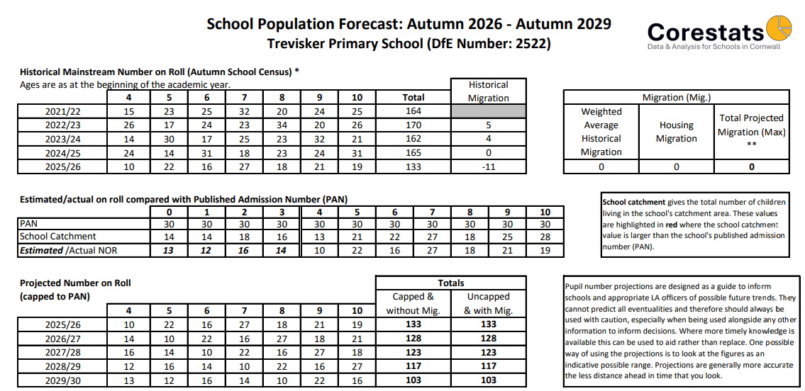
Falling rolls – impact on my school
Notes:
Example of a ‘Falling Rolls’ school (there are, as you can probably understand) lots of examples in Cornwall currently!
Note the falling catchment statistics – it is not even, it is not nice and smooth, some years buck the trend locally. One must also remember that older local cohorts have been able to grow through net migration over a long period (compared to new 0, 1 and 2 year old cohorts). However, the trend is there nonetheless. I would encourage schools to look at how local populations within your catchment vary by age. Have a look at older analysis – how have individual age groups changed? Worth noting that net migration is likely to be a single digit number in total spread across all age groups – i.e., for most catchment areas, annual net migration for a single age group is likely to be 0-1. Most rural areas are likely to see a 0-year old cohort grow between 2 and 4 children at most by the time the cohort reaches Reception age. For the example school above, cumulative net migration is likely to be 0 given there is no housing planned for the area. Also worth noting there is no evidence from historic migration within the school to support increases due to parental choice or local influx of families into the area.
For this school, the big change came in September 2025, when the school lost a large Y6 class which was replaced by a small Reception intake. This is why the change is gradual and not sudden – it starts with a low Reception intake, which then repeats for a few years leading to a slow decline in overall pupil numbers. Eventually, the decline stops when all of the ‘larger’ cohorts have left and what remains is a school with much smaller yeargroups throughout the school.
For this school numbers remained fairly stable until 2024 – this is something else schools need to be aware of. Parental choice means that for some schools declines in pupil numbers may be delayed (or may not happen at all). However, for every school where pupil numbers remain stable, this simply means that another school nearby is likely to see a much sharper decline in pupil numbers. Cornwall Council’s preference is for all schools to share the burden of falling pupil numbers to avoid (as far as possible) having to close schools. Underlying data shows us that, other than a few very specific parts of Cornwall, underlying NHS populations are fairly robust (they have fallen, but not to zero), and are generally still large enough to support schools (albeit with smaller numbers on roll).
We do have examples where a school has strong numbers within catchment, but nearby schools are pulling children away from the school, leading to much smaller numbers on roll. Whilst we accept parental choice, and recognise the importance of allowing parents to choose where their child attends school, we also need schools to work together to ensure that the right number of places are available. Over capacity (through leaving PANs too high compared to local demand) can leave schools absorbing pupils from outside of catchment (particularly in relation to our town schools) and inadvertently impacting nearby schools.
This school would have likely been operating 6 or perhaps 7 classes back in 2022/23. How many classes do you think this school should be operating by 2029/30 given a NOR projection of 103? Answer: Certainly not 7 (or even 6)! Not as simple to determine what the optimal number would be, given the distribution of children by age across the school, and the fact that the school is still operating with a PAN of 30!? I would be recommending (based on school catchment data and projected incoming Reception cohorts) that this school consider setting a PAN of 15 going forward, and planning to eventually reduce to 4 classes (Reception, Y1/Y2, Y3/Y4, Y5/Y6).

Slide 9
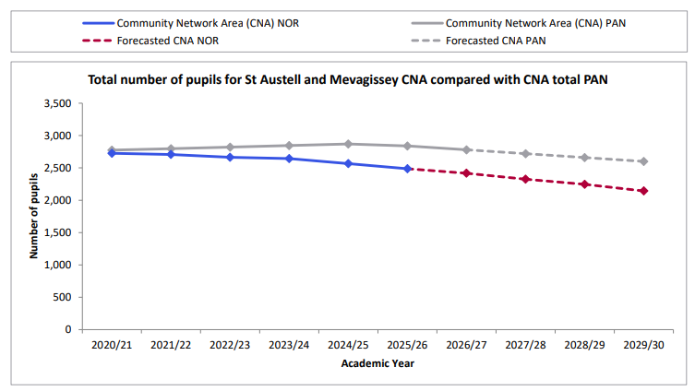
Falling rolls – impact on my school
Notes:
In addition to the main forecasting documents, there is a forecasting ‘graph’ document.
This helps to underline the recent changes in the size of school cohorts in both the county and across your own local area.
In particular each school should have a page showing the total ‘capacity’ of all primary/secondary schools in the local area, and the corresponding current NOR and projected NOR. This again helps to put the school’s own projected numbers in context. Your school may not have indicative falling rolls projections, but your area may none the less show growing spare capacity, indicating that other schools in your local area are projected to suffer from falling rolls. With changes to school popularity, it may not take much for your school to suddenly find itself in a position where intakes are falling, or more children are leaving your school to join other local schools due to preference. It is good to be aware of these trends – it also underlines the importance for schools to talk to one another. If schools can work together to close the ‘spare capacity’ gap (by reducing PANs) this should mean that the impact of falling rolls is shared across a local area (as far as possible).

Slide 10
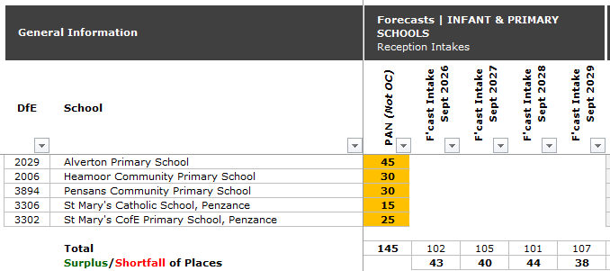
Example PANs v Forecasts:
Penzance TOWN Primary Planning Area
Notes:
First thing to note – projections aren’t static. Last year, for Penzance town, we were projecting Reception intakes of 95 and 96 for 2027/2028. Fast forward a year and these are now 105 and 101. This is good news (at least for Penzance town). PAN capacity has also reduced from 160 to 145 (one school has reduced PAN). However, you will note that the overall PAN capacity of the 5 schools is still around 40 places too much. Even allowing for 10% spare capacity, combined PAN should be around 115 to 120.
This information isn’t traditionally available to schools (it is actually an excerpt from an internal document the council uses to monitor capacities and projected NOR). However, we are beginning to share this data more with schools and I will explain how schools can hear more about their local area/local PANs v projected Reception cohorts on the next slide.

Slide 11
What is the Local Authority doing?
Commitment not to support school closures*
Working with schools and trust to utilise spare capacity within schools
Working with schools and trusts to manage PAN capacities
Notes:
*Unless there is clear evidence of a lack of demand, suitable alternatives close by, and there is already clear support within the local community for school closure. In the last 8 years, Cornwall has seen 2 schools close, both on the Lizard where pupil numbers dropped into low single figures indicating that parents had already voted through action that their local school should close. One other school closure is planned for September 2027 – TNIS – it should be noted that the initial suggestion for this came from TNIS/Carbeile and was supported by the LA because we could clearly see a lack of demand, suitable alternatives (essentially, the schools are merging onto one site). Whilst both schools could have continued separately, the costs were prohibitive – it should also be noted that significant efforts to consult the local community were undertaken and careful consideration was given before a decision was taken.
You will no doubt be aware of the significant issue in supporting children with SEND to be able to access appropriate education provision in Cornwall (that is also cost effective for the council). We have been working tirelessly with schools to identify suitable spare capacity that aligns with strategic priorities for new SEND provision and that will allow us to create new SEND capacity within Cornwall.
Finally, we are working with schools and trusts to ensure all of our schools across Cornwall have suitable PANs set. In fact, we have a series of meetings we have invited schools and trusts to attend in October which will highlight some of what we’ve touched on today, but at a more localised level.
We ran similar sessions last year. These will include some of what you’ve heard today, but also a more in-depth look at specific geographic areas (based on the schools attending). These are to support schools in making informed decisions about their school capacities/PANs/class organisations going forward, and to provide schools with some localised context beyond their own school.

Slide 12
What schools can do
Don’t panic
Set budgets using realistic pupil numbers
Talk to other local schools and trust
Consider PAN reductions
Consider class restructures
Notes:
I think the first point is the hardest to get your head around, but hopefully some of the contextual data today has underlined that shrinking Primary cohorts is inevitable when live births decline by 33% over 16 years. There isn’t anything schools can do to magic up more children in their local area – what schools can do is plan for smaller incoming cohorts and work with other schools locally to ensure all schools are providing the right number of Reception places in the local area.
One other thing that isn’t up on screen – help raise awareness amongst your school governors about the current situation and remember that falling pupil numbers is not (generally) a sign of failure but is simply a consequence of changing demographics.
With regards to the 4th point – PAN reductions – Sarah is now going to explain operationally how schools go about reducing PANs (once they’ve been through their forecasts and had discussions with other local schools and trusts/the LA to agree actions within your local area).

Slide 13
How do I change my school’s PAN?
A school’s Admission Authority is responsible for carrying out statutory consultation to reduce the Published Admission Number (PAN) (C/VC schools = Cornwall Council, academies = academy trust, trust/VA schools = governing board).
PANs are set annually as part of a school’s wider admission arrangements.
Next opportunity to make a change: for 2028/29 arrangements which must be determined by 28 February 2027.
Consultation for at least six weeks between 1 October 2026 and 31 January 2027.
Consultees are listed in the School Admissions Code – and guidance is available from the School Admissions Team.
Notes:
NB: Failure to consult effectively may be grounds for subsequent complaints and appeals.
OSA advice: good consultation – whether by local authorities or schools – uses a number of different ways to reach those who may have an interest. It will include a prominent and simple message on the front page of the relevant website, backed up with more detailed information and use of print and social media.
Already-determined PAN (if questioned):
PANs that have been determined can only be changed if a formal request for a variation is agreed.

Slide 14
PAN: things to remember
The PAN, once set for a particular year of entry, is binding.
The PAN only applies to the year of entry (i.e. reception in a primary school).
The PAN applies for the whole of the year of entry, you can’t restrict numbers below the PAN.
You can admit over PAN if you want to.
A suitable PAN gives you flexibility and helps you plan better.
Other year groups have what we call an ‘Admission Number’ which is not binding. It’s important that schools let us know the capacity for all their year groups so these can be reflected in Synergy SAM and so that we have accurate information about the number of places available.
It’s also really important that schools regularly update their attendance counts in Synergy SAM and let us know about class organisation changes.
Unsure about anything? See the Admissions area in the Schools Platform or if you can’t find what you need there, email schooladmissions@cornwall.gov.uk
Notes:
So, if you set a PAN of 20 but get 30 pupils eligible for a place you can accept 30 and have a full year group move up through the school. Equally if you set a PAN of 60 and get 38 pupils eligible for a place you can’t restrict this to 30 to avoid having to run a second class.
For example, if your PAN is 30 for a Reception intake, but you only have 22 Reception children join at the start of the academic year, you would still be expected to take up to a further 8 Reception children, if required, during the academic year that these children are in Reception.

Slide 15

Questions?

Slide 16
Thank you / Meur ras
If you have any questions or comments
peter.batten@cornwall.gov.uk
sarah.lewis@cornwall.gov.uk

